Slide 1
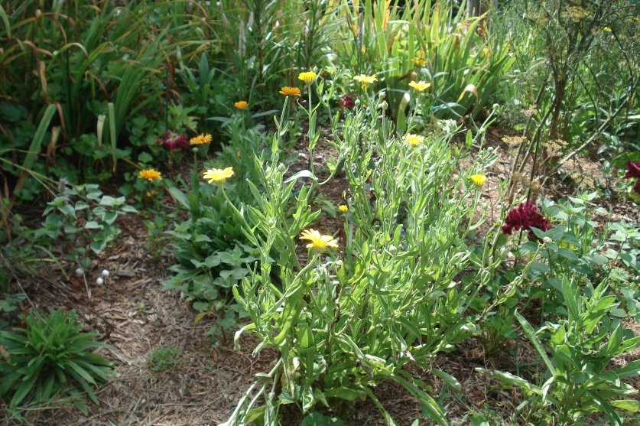
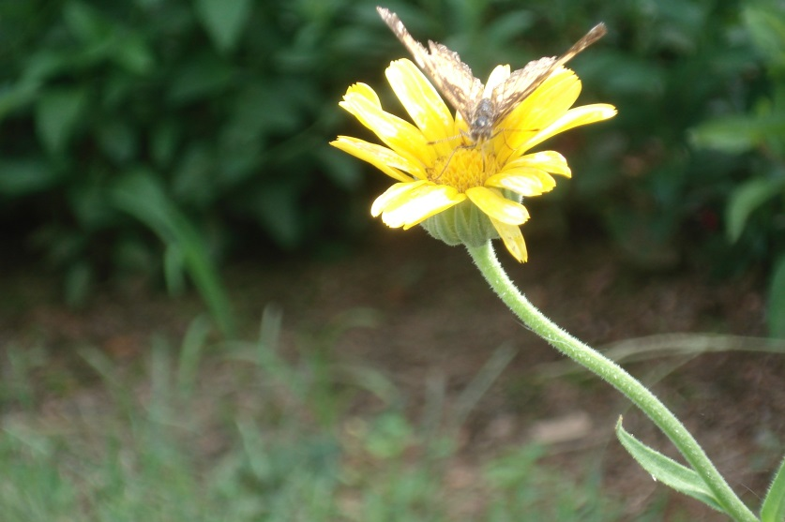
Jefferson’s Gardens: A Landscape of Opportunities c Section 1: A Perpetuating Flower Garden c “I am but a son of nature, loving what I see and feel, without being able to give reason, nor caring much whether there be one.” (T. Jefferson letter to Maria Cosway, Paris, April 24, 1788) Photos by D. Gerlach of “The Marygold”; One of Jefferson’s favorite flowers; photos taken at The Center for Historic Plants, Tufton Farm, August 1, 2013. “Seeds of this hardy annual were planted by Jefferson at his boyhood home, Shadwell, in 1767. Often called "marygold" by gardeners before 1800, this species has been used for culinary and medicinal purposes since the Middle Ages.” (http://www.monticello.org/site/house-and-gardens/in-bloom/calendula)
Darla Gerlach, EdD, Barringer Research Fellow, 2013

Slide 2
In this section, students will develop an understanding and appreciation of the breadth and depth of the planning involved in the flower beds at Monticello and the continual care to assure that plants are perpetuated for future enjoyment not only at Monticello but in the students’ gardens and communities as well. In preparation for this unit, students should review:
“In Bloom at Monticello” to acquire an understanding of species in Monticello’s landscape: http://www.monticello.org/site/house-and-gardens/in-bloom. Note the various types of plants: Annual, Biennial, Perennial, Bulb, Woody Shrub, Deciduous Tree, Herbaceous Perennial Herb, and the month these species bloom.
And utilize: “Jefferson Documented Plants” from The Thomas Jefferson Encyclopedia, http://www.monticello.org/site/house-and-gardens/jefferson-documented-plants.
“Greenhouses”: http://www.monticello.org/site/house-and-gardens/greenhouses.
“The Southeast Piazza (Greenhouse)”: http://www.monticello.org/site/house-and-gardens/southeast-piazza-greenhouse.
“Explore the Gardens at the University of Virginia”: http://www.virginia.edu/uvatours/gardens/gardensExplore.html.
Thomas Jefferson Center for Historic Plants (“Jefferson also maintained five satellite farms surrounding Monticello: Milton, Tufton, Lego, Shadwell, and Pantops. Tufton Farm is now home of the Thomas Jefferson Center for Historic Plants.”) http://www.monticello.org/site/house-and-gardens/thomas-jefferson-center-historic-plants.
African American Gardens at Monticello: http://www.monticello.org/site/house-and-gardens/african-american-gardens-monticello.
Thomas Jefferson: Florist, Twinleaf Journal Online, 2006, Thomas Jefferson Center for Historic Plants, http://www.monticello.org/site/house-and-gardens/twinleaf-journal-online.
Refer to the Photo Gallery online: this is a collection of photographs taken by Darla Gerlach; referencing: Monticello flower beds, orchards, University of Virginia gardens and the Thomas Jefferson Center for Historic Plants.

Slide 3
As students proceed with this lesson in the project, encourage them to keep in mind the following individuals’ thoughts who cultivate the gardens at Monticello:
“Jefferson used the garden as a teaching experience and encouraged his grandchildren to participate in and observe the process of gardening.” Peggy Cornett, Curator of Plants
“Keep your eyes open and look at nature closely; observe the world around you.” Debbie Donley, Flower Gardener
“The more kids are exposed to plants, the more they care about them; they’re more likely to appreciate them.” Amy Jeffries, Garden Superintendent
Procedures for Lesson:
Review the section: “Thomas Jefferson: An Age of Enlightenment Thinker” and respond to the correlating questions as a class discussion or as an individual student assignment.
Review the section: “Sharing Knowledge: Collecting, Distributing and Exchanging Seeds and Plants” and respond to the correlating questions as a class discussion or as an individual student assignment.
Review the section: “Jefferson’s Granddaughters as Gardeners: Thomas Jefferson’s letter to his granddaughter, Anne Randolph, June 7, 1807” and respond to the correlating questions as a class discussion.
Students will complete an activity in “Sharing Knowledge: Exchanging Seeds.”

Slide 4
Thomas Jefferson: An Age of Enlightenment Thinker
What is The Age of Enlightenment?
An intellectual movement which began in England in the seventeenth century, but then spread to have eventual influence over all sections of the world. The term "Enlightenment," rooted in an intellectual skepticism to traditional beliefs and dogmas, denotes an "illumined" contrast to the supposed dark and superstitious character of the Middle Ages. From its inception, the Enlightenment focused on the power and goodness of human rationality. Some of the more characteristic doctrines of the Enlightenment are: 1) Reason is the most significant and positive capacity of the human; 2) reason enables one to break free from primitive, dogmatic, and superstitious beliefs holding one in the bonds of irrationality and ignorance; 3) in realizing the liberating potential of reason, one not only learns to think correctly, but to act correctly as well; 4) through philosophical and scientific progress, reason can lead humanity as a whole to a state of earthly perfection; 5) reason makes all humans equal and, therefore, deserving of equal liberty and treatment before the law; 6) beliefs of any sort should be accepted only on the basis of reason, and not on traditional or priestly authority; and 7) all human endeavors should seek to impart and develop knowledge, not feelings or character. (http://www.pbs.org/faithandreason/gengloss/enlight-body.html
Review Jefferson’s concept of flower beds at: http://explorer.monticello.org/; click on Gardens and Grounds.

Slide 5
Sharing Knowledge: Collecting, Distributing and Exchanging Seeds and Plants
In Philadelphia, December 24, 1809, T. Jefferson wrote to Bernard McMahon. According to Barbara McEwan (1991):
“In 1806 Jefferson was literally presented with the first really useful and adequate book on horticulture published in America: Bernard McMahon’s The American Gardener’s Calender. McMahon was a Philadelphia nurseryman with whom he would transact business again and again…McMahon was more than a merchant of plants and seeds. He can be described as America’s first landscape gardener. Although he relied heavily on Humphrey Repton, the English authority in the field, McMahon managed to translate the rate of naturalistic design then sweeping England to the American situation. When Jefferson first came to know this remarkable man is not known. Ever the gardener, it is hard to believe he did not make McMahon’s acquaintance soon after the latter established business, which seems to have been done soon after coming to this country (U.S.) in 1796.
McMahon abounds in advice. Gardeners should ‘consult the rural disposition in imitation of nature.’ He advised ‘abolishing long straight walks,’ recommended ‘rural open spaces of grass-ground’ and suggested ‘winding walks, all bounded with plantations of trees, shrubs, and flowers in various clumps.’ Jefferson had already achieved some of this at Monticello, but it is of interest that the winding walks and flower beds behind the mansion were sketched out by him the year after McMahon gave him a copy of the book. It would serve many others for fifty years as the standard authority in various areas of gardening, going through eleven editions, the last in 1857.” (McEwan, pp. 13-14).

Slide 6
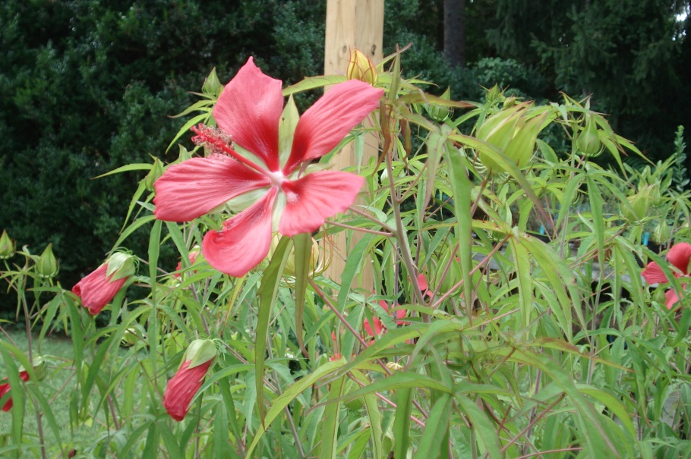
Sharing Knowledge: Collecting, Distributing and Exchanging Seeds and Plants cont.
In Thomas Jefferson’s Garden Book , 1766-1824, annoted by Edwin Morris Betts, it is noted that Jefferson was concerned about plants being transported from Europe to the U.S.
“On February 7 Jefferson sent a list of plants, similar to the ones he had sent the previous year to Mr. Bartram and to Mr. Cary, to Mr. John Banister, Jr. The list of plants was accompanied by detailed instructions on packing and sending them. (Letter and list of plants, Jefferson Papers, L.C.)
Shipping plants from America to Europe in Jefferson’s day involved great difficulties. Usually more plants died in transport than survived, either because the shipments were allowed to stand for months on the wharves awaiting adequate shipping space, or because they were unable to weather the lengthy sea voyage, often of several weeks or months. On account of this uncertainty Jefferson usually preferred his friends sending him seeds rather than plants. A letter from Jefferson to Andrew Limozin, his agent in Havre, France, shows the difficulties involved in sending plants:
“….“There is danger therefore of their losing their vegetative power by delay…” (Paris, February 11, 1787).” (p. 121-122)
Photo by D. Gerlach August 1, 2013 at Thomas Jefferson Center for Historic Plants

Slide 7
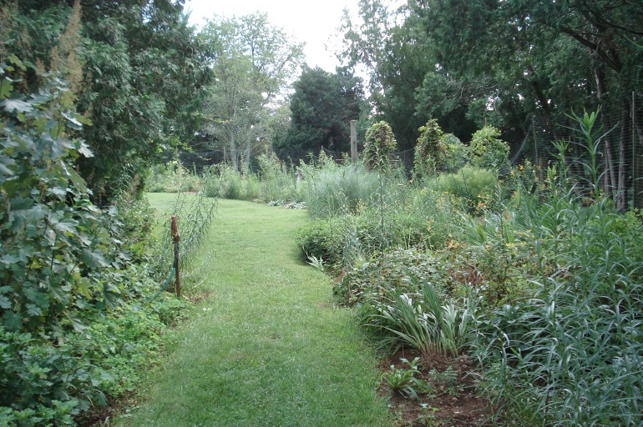
Sharing Knowledge: Collecting, Distributing and Exchanging Seeds and Plants cont.
Questions to Ponder:
Did McMahon influence Jefferson’s garden designs or did Jefferson incorporate his observations from many of the gardens he visited in Europe into his Monticello gardens?
What obstacles did Jefferson have to consider in the transportation of seeds from one fellow gardener to another?
What types of materials could have been used during Jefferson’s era to safely ensure the transport of seeds and plants?
Compare and contrast how seeds are packaged nowadays to that of Jefferson’s era. How are plants packaged nowadays to ensure their safety from one destination to another?
Think of the various places where you, your family and neighbors can purchase seeds and plants today in your community.
Photo by D. Gerlach August 1, 2013 of garden pathway at Thomas Jefferson Center for Historic Plants

Slide 8
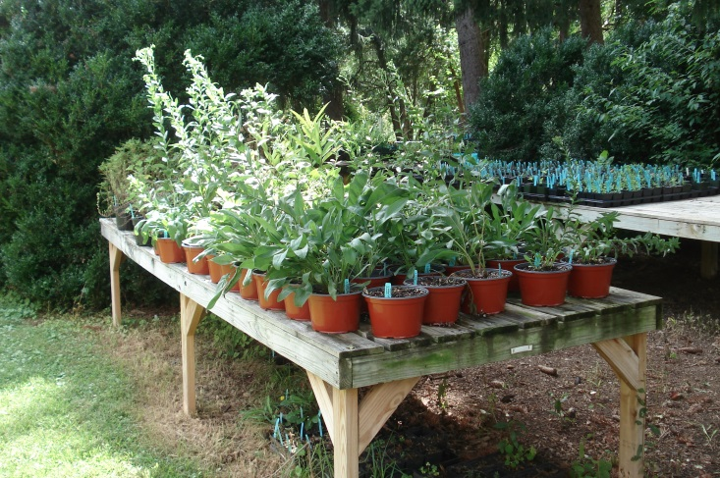
Sharing Knowledge: Collecting, Distributing and Exchanging Seeds and Plants cont.
In her book, Thomas Jefferson: Farmer, McEwan notes:
“It is curious that Jefferson’s library lacked a copy of Mrs. Martha Logan’s The Gardener’s Kalender, which was published in 1779 after her death at age 77. She was quoted for years as an authority on the subject. Jefferson, who did his best to convert his two daughters into gardeners and who succeeded with his oldest granddaughters, should have been delighted with Mrs. Logan’s expertise , not to mention her general abilities. In addition to writing, she sold garden seeds and plants, managed a plantation, and boarded and taught children in her South Carolina home.” (McEwan, 14).
Questions to Ponder:
Why wasn’t a copy of Mrs. Logan’s book in Jefferson’s library?
Why do you think the author noted this curiosity in her account of Jefferson’s portrayal of himself as a farmer?
Photo by D. Gerlach, August 1, 2013 of potted plants at Thomas Jefferson Center for Historic Plants

Slide 9
Jefferson’s Granddaughters as Gardeners
Students should review Jefferson’s letter (see below) to his granddaughter, Anne Randolph, on June 7, 1807, indicating his plans for the winding walk surrounding the lawn – West Side of the house:
“…I find that the limited number of our flower beds will too much restrain the variety of flowers in which we might wish to indulge, & therefore I have resumed an idea, which I had formerly entertained, but had laid by, of a winding walk surrounding the lawn before the house, with a narrow border of flowers on each side. This would give us an abundant room for a great variety, I enclose you a sketch of my idea, where the dotted lines on each side of the black shew the border on each side of the walk. The hollows of the walk would give room for oval beds of flowering shrubs.
(Thomas Jefferson’s Garden Book, ed. Edwin Morris Betts, 1943, p. 349).
Review the following sites:
Monticello Explorer: Gardens and Grounds and http://www.monticello.org/site/house-and-gardens/winding-flower-border.
http://www.monticello.org/site/house-and-gardens/jeffersons-botanical-perseverance.
http://www.monticello.org/site/plantation-and-slavery/living-slavery-monticello-i-and-monticello-i.i
Questions to Ponder for class discussion:
Find evidence of Thomas Jefferson’s organized method of thinking (Enlightenment influence) in the structure of his gardens, flower beds and landscape at Monticello.
Do you think Jefferson’s granddaughters strictly followed their grandfather’s garden schematic while working in the garden and/or would they incorporate their designs as well?
Thomas Jefferson was considered an aristocrat by many. Compare this role to his communication with gardeners on his estate—is there a common ground?

Slide 10
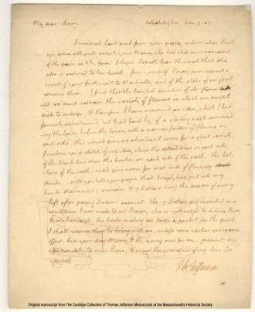
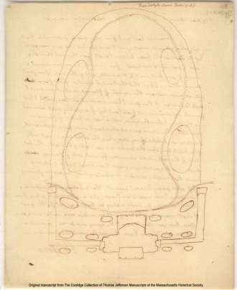
Jefferson’s Granddaughters as Gardeners
Monticello: letter and garden/flowerbeds (layout), recto, 7 June 1807, by Thomas Jefferson. N147gg; M15 [electronic edition]. Thomas Jefferson Papers: An Electronic Archive. Boston, Mass. : Massachusetts Historical Society, 2003. http://www.thomasjeffersonpapers.org/
Jefferson’s sketch of garden location showing flower beds – West Lawn area

Slide 11
Sharing Knowledge: Exchanging Seeds
The following activity is the culmination of this particular unit, A Perpetuating Flower Garden. The lesson was developed in coordination with Debbie Donley, Peggy Cornett and Amy Jeffries, Monticello.
Students have the opportunity to observe flowers in their own gardens and select a flower of their choice to collect seeds and perpetuate the flower for the next growing season. Refer to “Notes & Sketches” Handout to record information about a flower.
Procedures for Harvesting Seeds:
Start by recognizing when plant stem is turning brown; when the seed pod is beige or brown or some seed capsules are actually opening. Harvesting (removing the seeds) takes place when the plant or pod is dry; not wet (i.e. dew formed on plant).
After gathering seeds, label them using botanical name of plant (one seed may look similar to another seed variety). Note the date the seeds were collected.
Spread out the seeds in a cool, dry, dark place.
After several weeks, stir around the seeds.
Harvest the seeds in boxes—tape the corners to prevent the seeds from escaping.
At this time, seeds may be “cleaned”; the chaff (dry, protective cover) on the seed may need to be removed. This can be accomplished by placing the seeds in a sieve, window screen or gently rubbing the seeds and blowing off any extra chaff. When using a sieve or window screen, you will note that the seeds will rise to the top and chaff will remain on the bottom.
Store seeds in a cool, dark, dry place (this is very important). Use paper containers to store the seeds.
Suggested flower seeds to gather: zinnia, coxcomb, celosia, marigold, calendula (pot marigold)

Slide 12
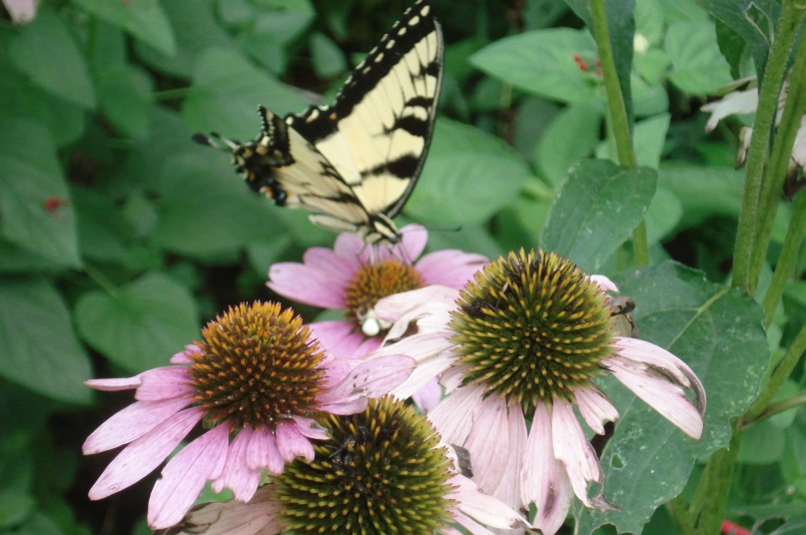
Sharing Knowledge: Exchanging Seeds cont.
Procedures for Creating a Seed Package:
Create a seed packet for seed exchange. Thomas Jefferson collected and exchanged seeds and plants with fellow garden enthusiasts both within the U.S. and in other countries. After students harvest their seeds, they can design and construct a hand-made paper seed packet to give as a gift or exchange with a fellow classmate.
A suggestion for a class activity: a Seed Exchange Day in which students can describe the features of their flower seeds and provide more in-depth information of where they collected their seeds (i.e. a family garden they created and any stories of plants that have been passed from one generation to another).
Suggested Site for Further Reading, Twinleaf Journal Online, 2007, Thomas Jefferson Center for Historic Plants: Seeds at Monticello: Saving, Storing, Sharing: http://www.monticello.org/sites/default/files/inline-pdfs/seedsatmonticello.pdf.
Photo by D. Gerlach, August 1, 2013
Coneflower at Thomas Jefferson Center for Historic Plants

Slide 13
Bibliography
Jefferson, Thomas. (2012). Thomas Jefferson’s Garden Book. Ann. Edwin Morris Betts.
Charlottesville, Virginia: The Thomas Jefferson Memorial Foundation, Inc.
McEwan, Barbara. (1991). Thomas Jefferson: Farmer.
North Carolina: McFarland & Company, Inc.
McMahon, Bernard. (1997). The American Gardener’s Calendar: Charlottesville, Virginia:
The Thomas Jefferson Memorial Foundation, Inc. (facsimile reprinted from the first
edition published in Philadelphia, 1806).

