Slide 1
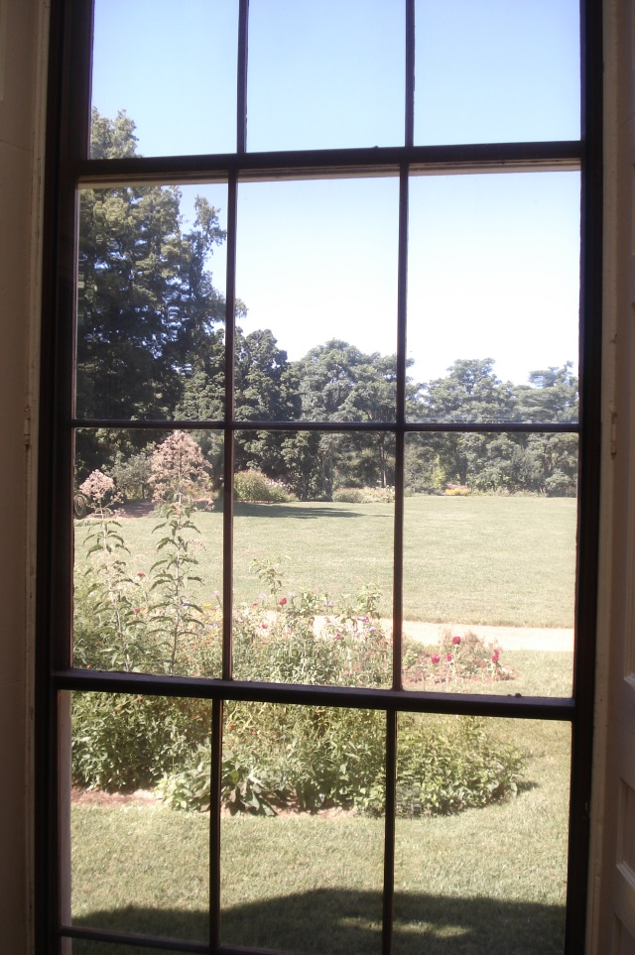
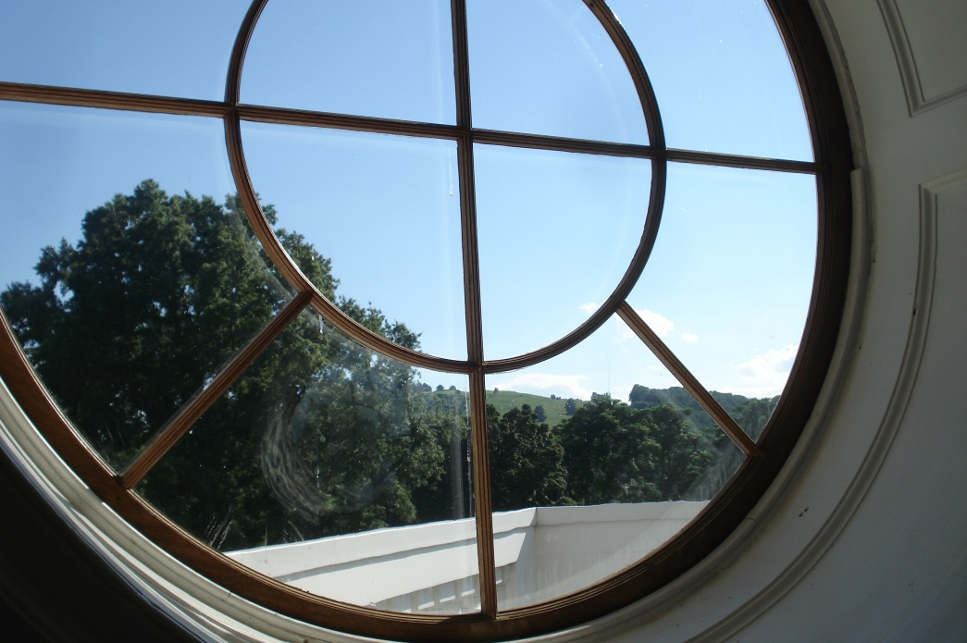
Jefferson’s Gardens: A Landscape of Opportunities c Section 3: Jefferson: Creating Personal Space for Self-Reflection c “Mr. J. went to his apartments, the door of which is never opened but by himself and his retirement seems so sacred that I told him it was his sanctum sanctorum.” (Margaret Bayard Smith, writing about her visit to Monticello on August 1, 1809. Smith, Margaret Bayard. First Forty Years of Washington Society. New York: Charles Scribner's Sons, 1906, p. 70.)
Looking through the window at Monticello
Photos by D. Gerlach
Darla Gerlach, EdD, Barringer Research Fellow-2013

Slide 2
c Jefferson: Creating Personal Space for Self-Reflection c
Are there architectural and landscape aspects of Thomas Jefferson’s homes at Monticello and Poplar Forest that reflect his need for private space?
Jack McLaughlin notes:
“Windows were an architectural paradox for Jefferson; they admitted the light and ventilation that he found essential for work and comfort, but they also denied him solitude and privacy. The venetian blind, with its adjustable louvers, was a filter that allowed him to control light and air without being seen. Blinds were at once a functional, utilitarian device and a symbol of the Jefferson personality. He was a man who revealed to others only what he chose to; he remained fixedly concealed behind what we would call his defenses—observing all but seldom revealing. Only with his close family, in the confines of the walls of Monticello, did he allow himself to be seen, to reveal his needs for, and his capacity to show, love and affection. These private feelings were not for public display; therefore as Jefferson’s fame grew during his presidency, and Monticello became increasingly an inn, his need to control his privacy intensified.” (McLaughlin, p. 327).
Read Route to Poplar Forest: http://www.monticello.org/site/research-and-collections/route-to-poplar-forest:
“In a letter to Benjamin Rush dated August 17, 1811, Thomas Jefferson states:
‘I write to you from a place ninety miles from Monticello, near the New London of this State, which I visit three or four times a year, and stay from a fortnight to a month at a time. I have fixed myself comfortably, keep some books here, bring others occasionally, am in the solitude of a hermit, and quite at leisure to attend to my absent friends.’ (Lipscomb and Bergh, Jefferson 13: 74-75 in Thomas Jefferson’s Garden Book, ed. E. M. Betts).”

Slide 3
c Jefferson: Creating Personal Space for Self-Reflection c
This section is divided into 3 areas to examine Jefferson’s wish for personal space and aesthetic privacy that enabled him to engage in self-reflection.
His use of landscape to create both beauty and privacy
The architectural features of his homes at Monticello and summer retreat, Poplar Forest, for solitude
Evidence of how he thought about his own thinking—metacognition
Jefferson was a constant thinker. He comments on idleness:
1787 March 21. (to Martha Jefferson Randolph). "Of all the cankers of human happiness, none corrodes it with so silent, yet so baneful a tooth, as indolence. Body and mind both unemployed, our being becomes a burthen and every object about us loathsome, even the dearest, Idleness begets ennui, ennui the hypochondria, and that a diseased body. No laborious person was ever hysterical. Exercise and application produce order in our affairs, health of body, chearfulness of mind, and these make us precious to our friends. It is while we are young that the habit of industry is formed. If not then, it never is afterwards. The fortune of our lives therefore depends on employing well the short period of youth. If at any moment, my dear, you catch yourself in idleness, start from it as you would from a precipice of a gulph. You are not to consider yourself unemployed while taking exercise."
Refer to: www.monticello.org/site/research-and.../finding-jefferson-quotations.

Slide 4
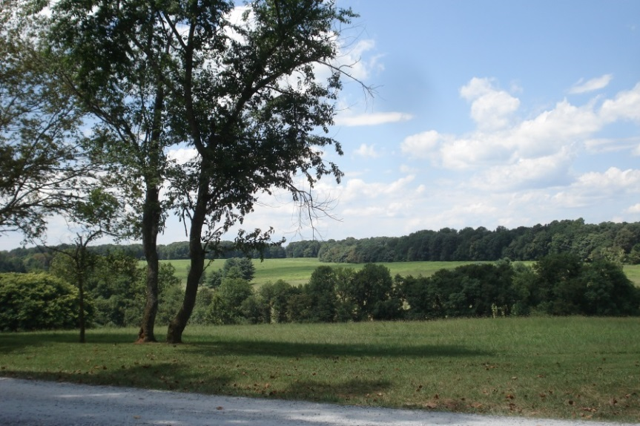
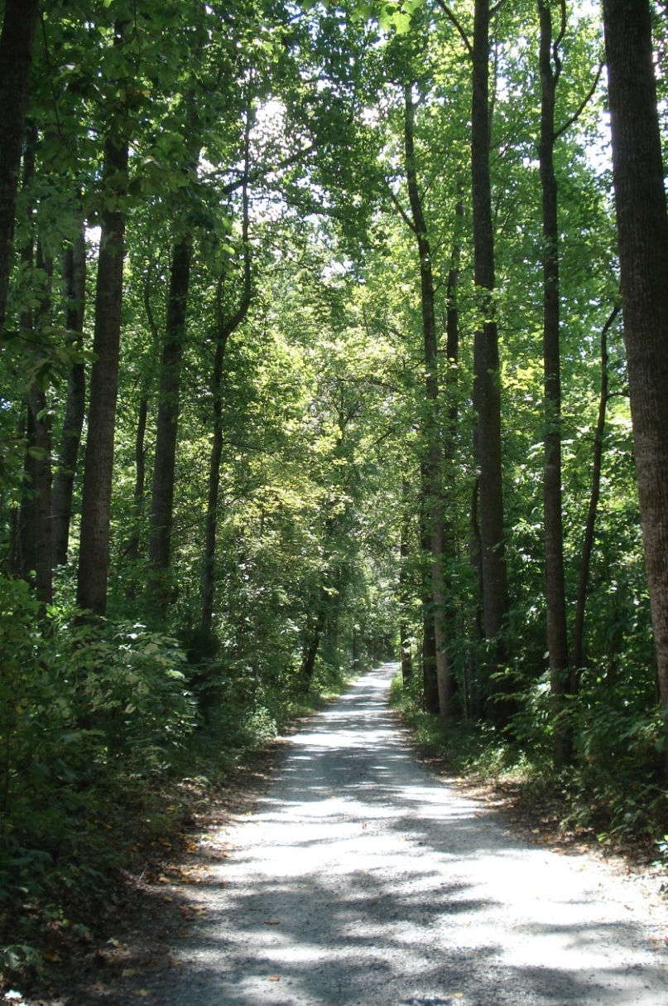
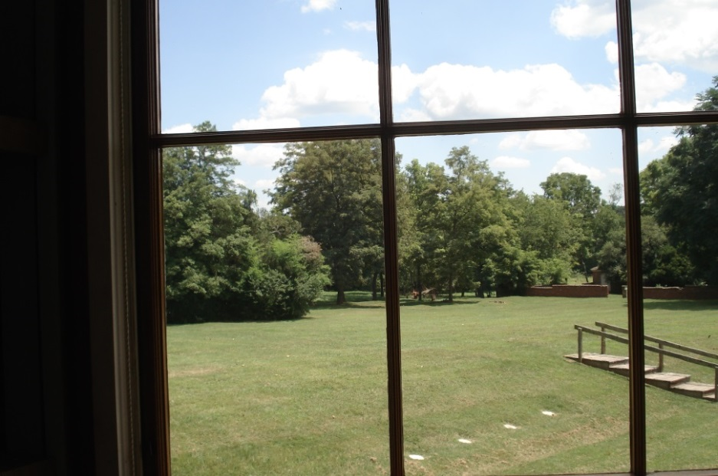
c Jefferson: Creating Personal Space for Self-Reflection c His use of landscape to create both beauty and privacy
Observe the following landscapes at Poplar Forest to acquire the sense of aesthetic privacy:
View of landscape from Poplar Forest
Driveway to front of house at Poplar Forest
The back lawn at Poplar Forest Photos by D. Gerlach;
August, 2013

Slide 5
c Jefferson’s Poplar Forest c
Facade of Poplar Forest Photo by Darla Gerlach;
August, 2013

Slide 6
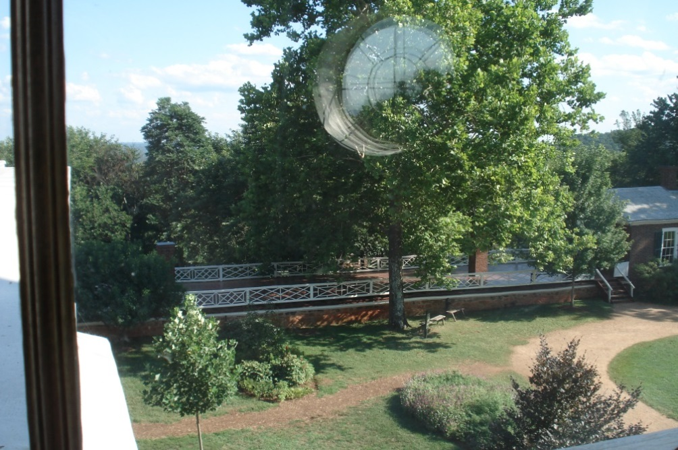
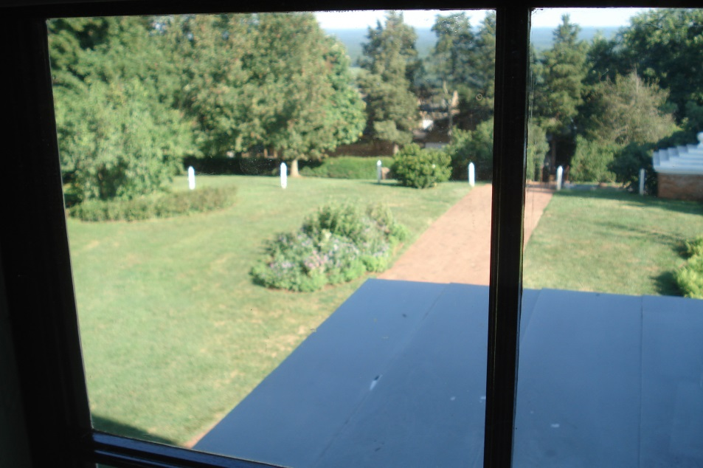
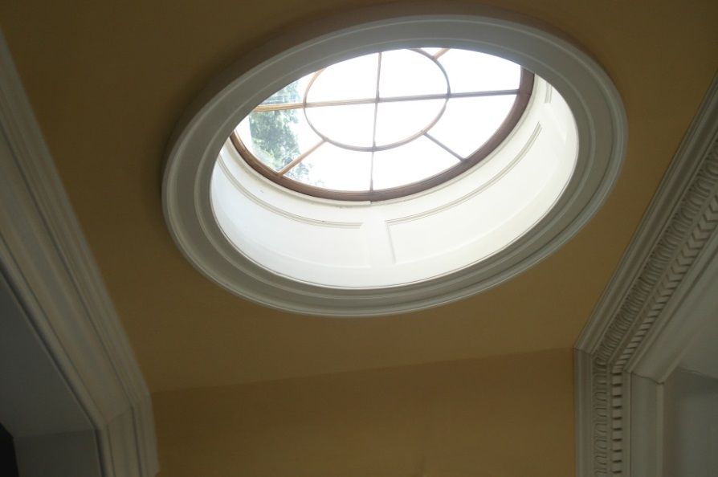
c Jefferson: Creating Personal Space for Self-Reflection c His use of landscape to create both beauty and privacy
Observe the following landscapes at Monticello to acquire the sense of aesthetic privacy:
Looking out the windows at Monticello
Photos by D. Gerlach, August, 2013
View of the sky from the “Dome” at Monticello

Slide 7
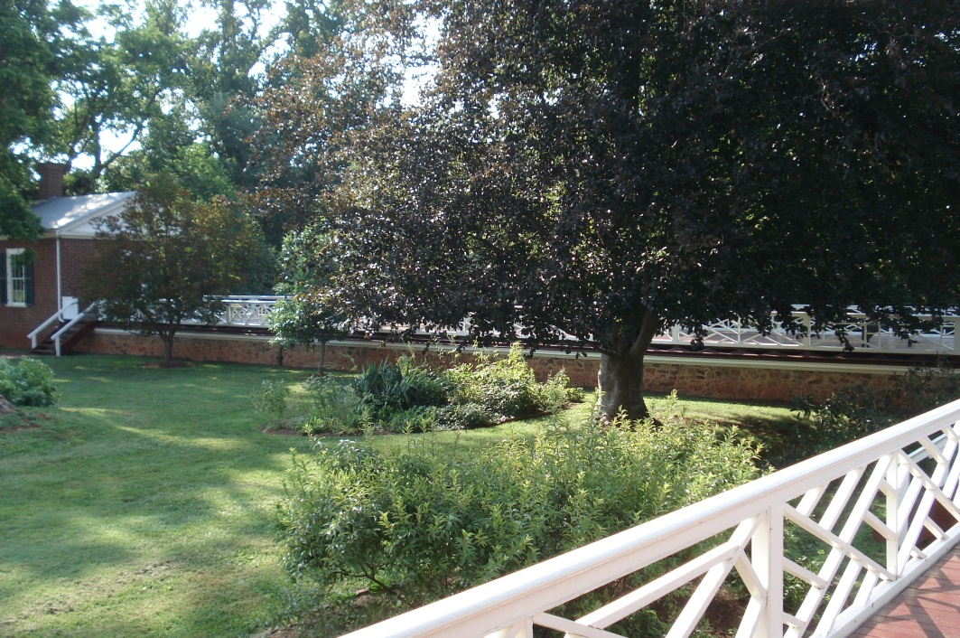
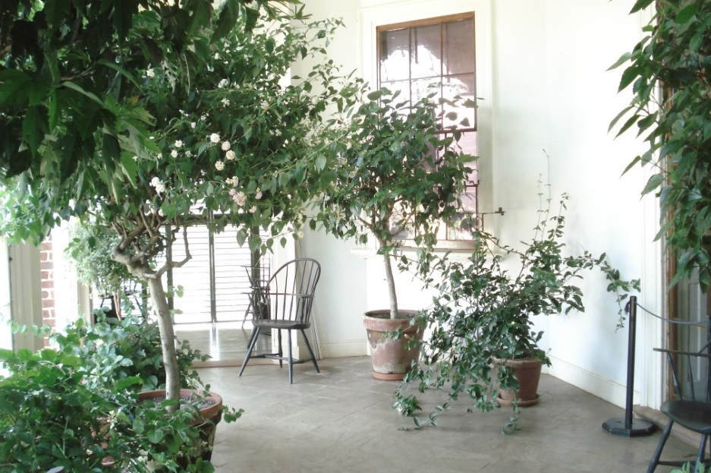
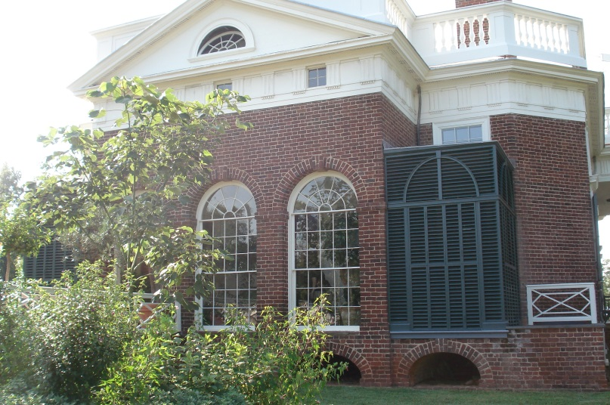
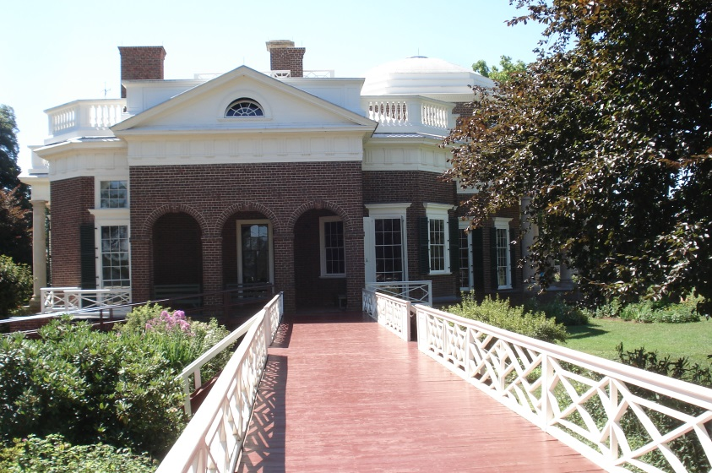
c Jefferson: Creating Personal Space for Self-Reflection c Jefferson’s use of landscape to create both beauty and privacy
Observe the following landscapes at Monticello to acquire the sense of aesthetic privacy:
Views of the Southeast Piazza (Greenhouse) & Porch
Views from the terraces
Photos by D. Gerlach;
August, 2013

Slide 8
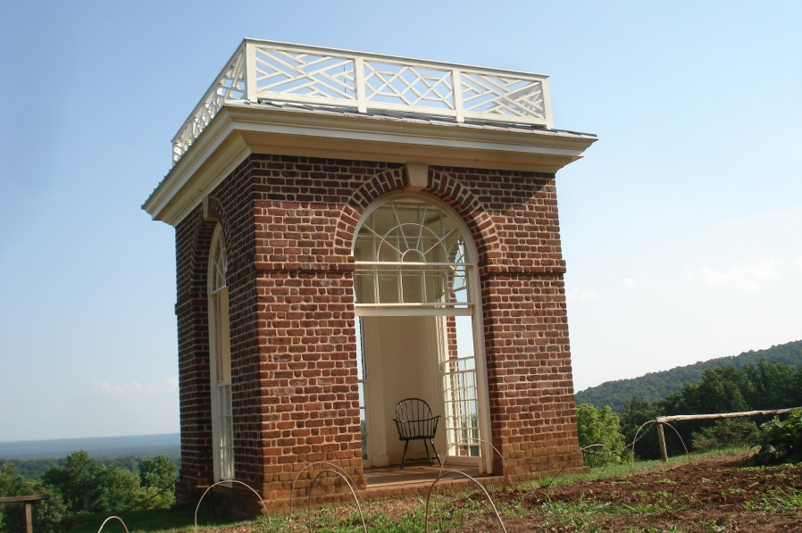
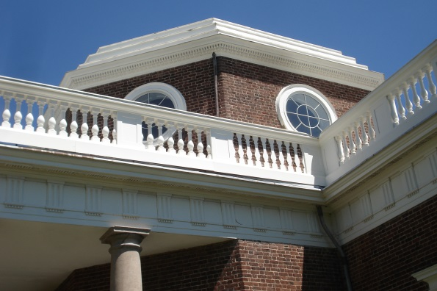
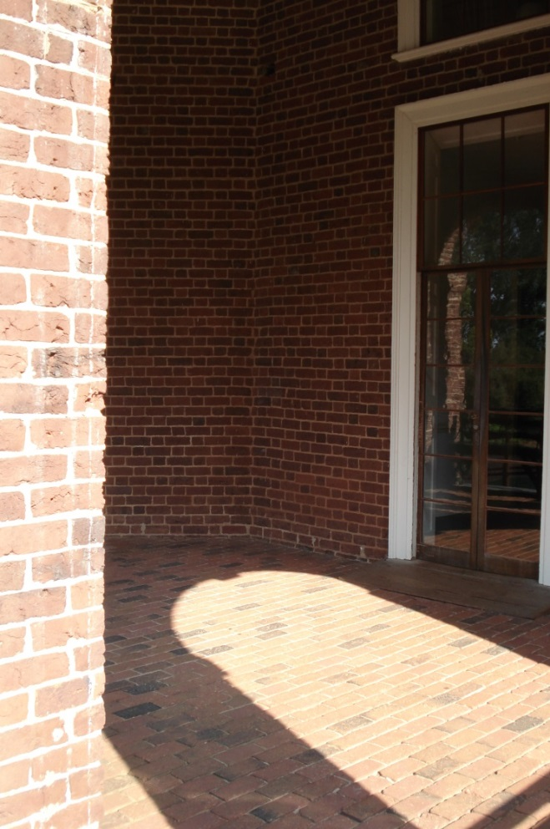
c Jefferson: Creating Personal Space for Self-Reflection c The architectural features of Jefferson’s home at Monticello for solitude
Observe the following architectural features that Jefferson designed at Monticello—what do these areas illustrate about his personality?
View of Doom Room or “Sky Room”
The Garden Pavillion
Northwest Piazza & Terrace
Photos by D. Gerlach;
August, 2013
Northwest Piazza

Slide 9
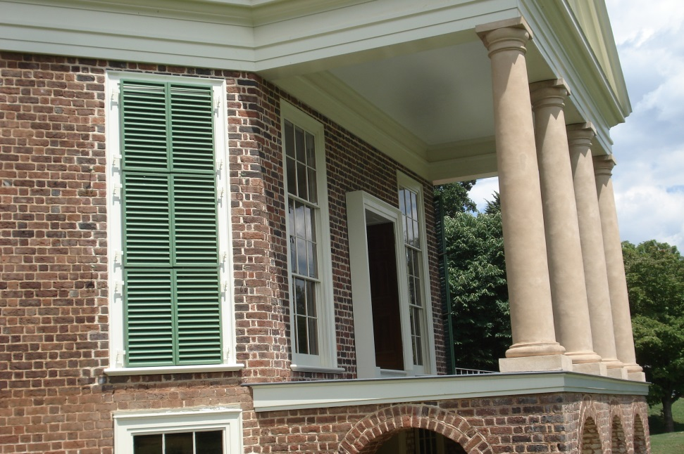
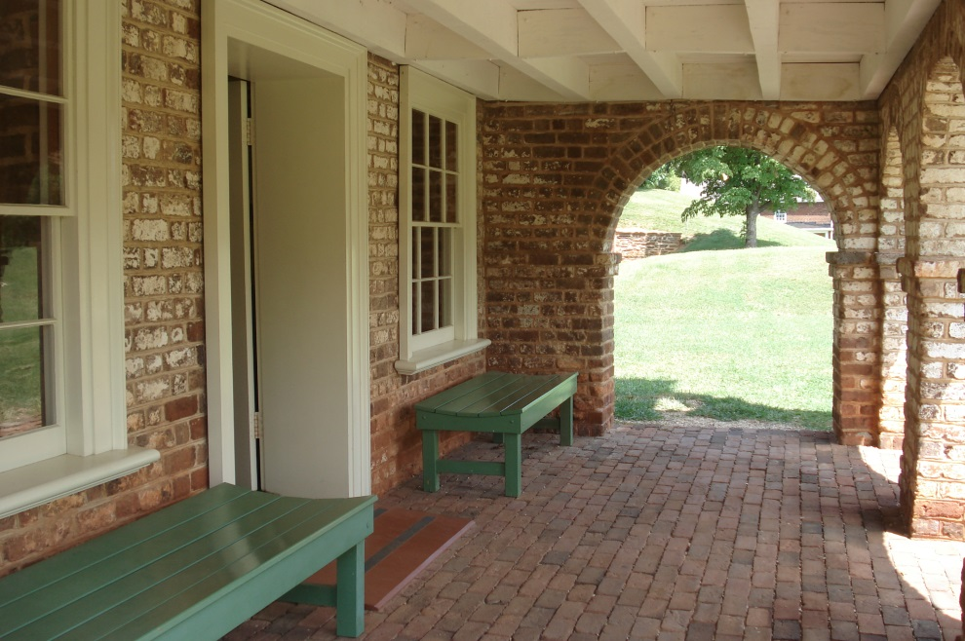
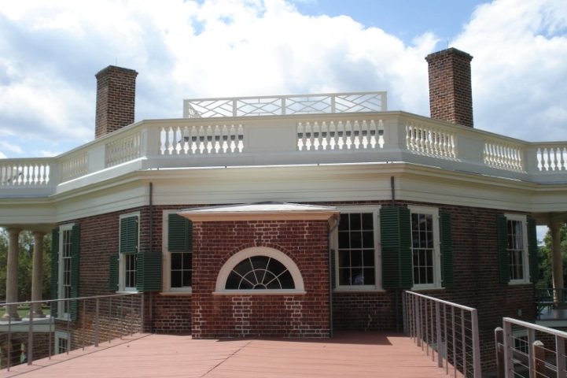
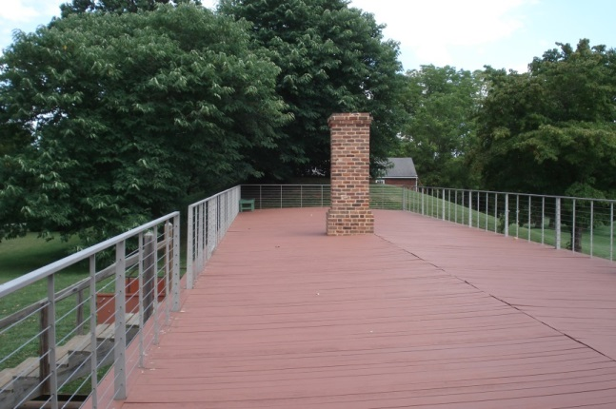
c Jefferson: Creating Personal Space for Self-Reflection c The architectural features of Jefferson’s summer retreat, Poplar Forest, for solitude
Observe the following architectural features that Jefferson designed at Poplar Forest—what do these areas illustrate about his personality?
View of the back porch which overlooks the “Sunken Lawn”
Lower exterior of home
Photos by D. Gerlach, August, 2013
Views of the Terrace

Slide 10
c Jefferson: Creating Personal Space for Self-Reflection c Evidence of Jefferson’s thoughts about his own thinking—metacognition
After viewing all of the photos of the architectural and landscape features of Jefferson’s homes, what can you conclude about the type of space he designed for himself?
Compare/contrast what “personal space” means to you. Is this space conducive for “quiet thinking” for you? At the end of a day, do you reflect on events that occurred throughout that day? Specifically, after you finish a school assignment or a test, do you reflect on your efforts? After you engage in a conversation with someone, do you think about the dialogue (i.e. what both of you said in the conversation)? “Thinking about your thinking” is termed metacognition. (Flavell, Miller, and Miller, 2002, p. 164).
Jefferson was a detailed thinker…he wrote reflective notes on items that he had already written. What does this illustrate to you? Engage in a class discussion to share thoughts about Jefferson’s written notes to himself. Here are a few examples of his metacognitive behavior: observe the numerous notes on the margins of Thomas Jefferson’s Notes on the State of Virginia, 1743-1826 (1787).
Is this example similar to someone proofreading their work? Do you consistently proofread your written work for clarity?
“The same facts impress us differently. This is enough to make me suspect an error in my process of reasoning tho’ I am not able to detect it.”
Thomas Jefferson’s letter to John Adams, Paris, July 11, 1786.

Slide 11
c Jefferson: Creating Personal Space for Self-Reflection c Evidence of Jefferson’s thoughts about his own thinking—metacognition
Self-reflection in a project-based learning experience affords students the opportunity to frame the task of creating a product and determining how they can best use their previous learning experiences and resources to construct an action plan to achieve their goals. Self-reflection is vital in the learning process as students assess and determine which strategies will produce successful results and help them accomplish their goals. (Gerlach, 2008, p. 65 and 66)
Flavell, Miller, and Miller (2002) believe that metacognition is a type of knowledge that is gradually acquired, “domain-specific,” and a “tool of wide application” since it can be utilized for solving many different kinds of problems. Metacognition is particularly important in the field of education where children engage in problem-solving skills and can double-check their process of completing a task and their end-product (Flavell et al., 2002 in Gerlach, 2008, p. 62).

Slide 12
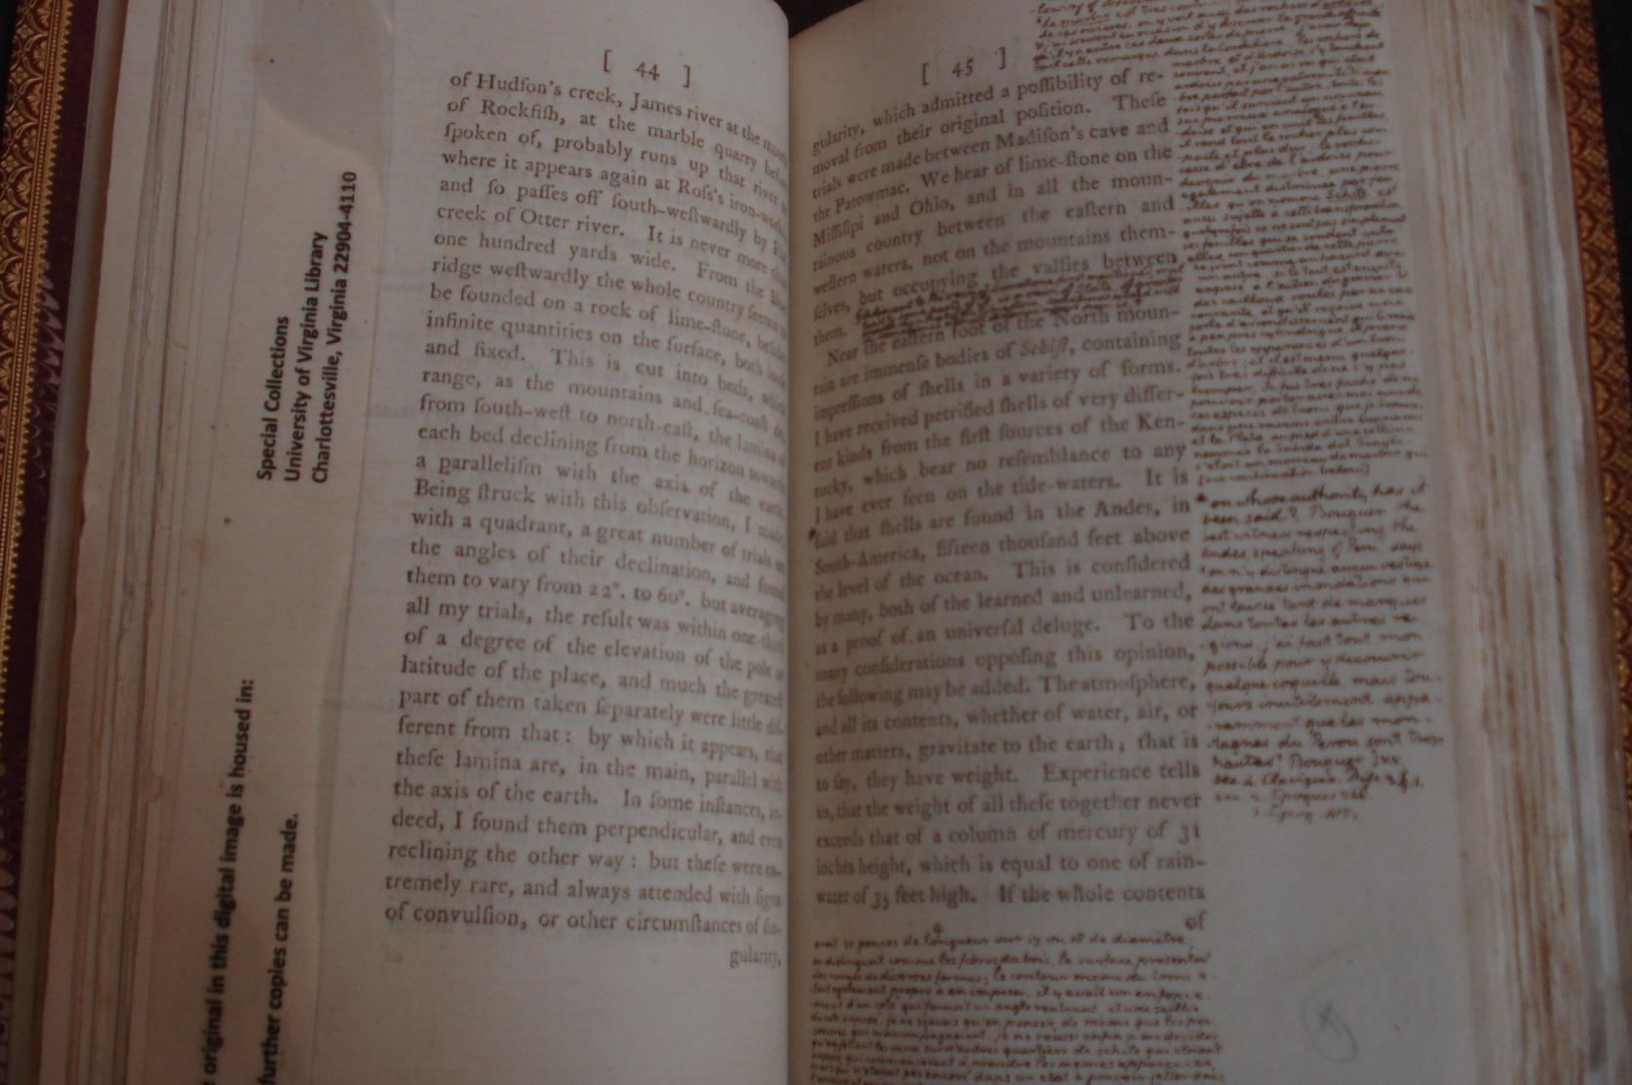
c Jefferson: Creating Personal Space for Self-Reflection c Evidence of Jefferson’s thoughts about his own thinking—metacognition
Thomas Jefferson’s Notes on the State of Virginia, 1743-1826 (1787). Special Collections, University of Virginia, Charlottesville, VA.

Slide 13
c Jefferson: Creating Personal Space for Self-Reflection c Evidence of Jefferson’s thoughts about his own thinking—metacognition
Thomas Jefferson’s Notes on the State of Virginia, 1743-1826 (1787).

Slide 14
c Jefferson: Creating Personal Space for Self-Reflection c Evidence of Jefferson’s thoughts about his own thinking—metacognition
Evidence of Thomas Jefferson’s method of “organized thinking”: observe many items of correspondence as well folded maps inside his book, Notes on the State of Virginia, 1743-1826 (1787).

Slide 15
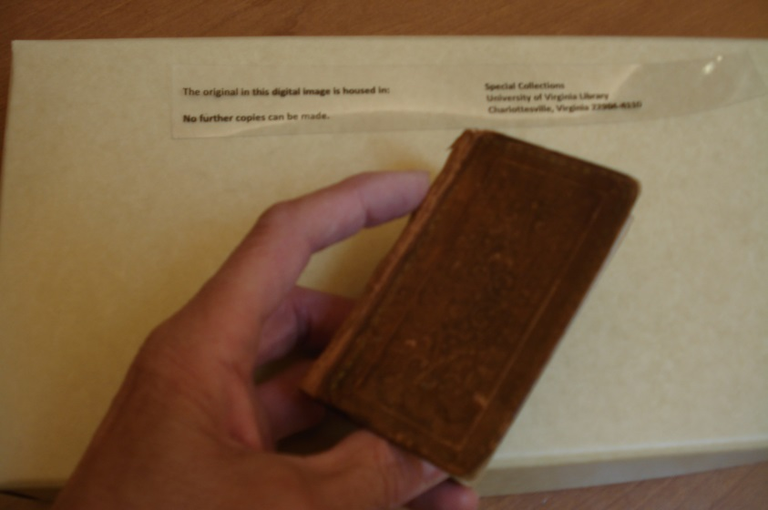
c Jefferson: Creating Personal Space for Self-Reflection c Evidence of Jefferson’s thoughts about his own thinking—metacognition
Jefferson was very fond of his retreat, Poplar Forest. In fact, it is said that he regarded this as his most cherished dwelling.
His granddaughters visited Poplar Forest and it is interesting to note that when Jefferson retreated to Poplar Forest for relaxation with his granddaughters, Ellen and Cornelia, he created a structured schedule for them which included playing the harpsichord. Jefferson spent his mornings at Poplar Forest reading and again in the evening. Since Poplar Forest was approximately a three-day trip from Monticello, Jefferson used petit-format books for easy traveling. These books were 3” x 5” or 4” x 6”. These books were kept in the parlor. (information obtained from Poplar Forest tour)
Refer to the photos of examples of petit-format books from the Special Collections Library at the University of Virginia.
Photo by D. Gerlach; August, 2013

Slide 16
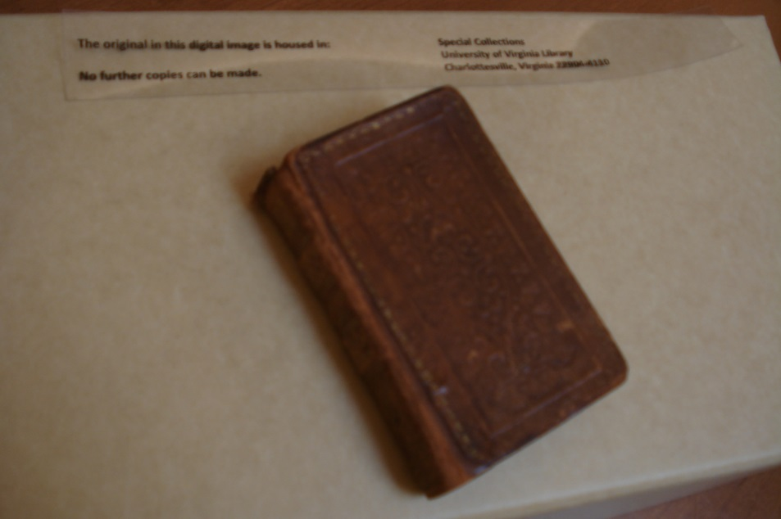
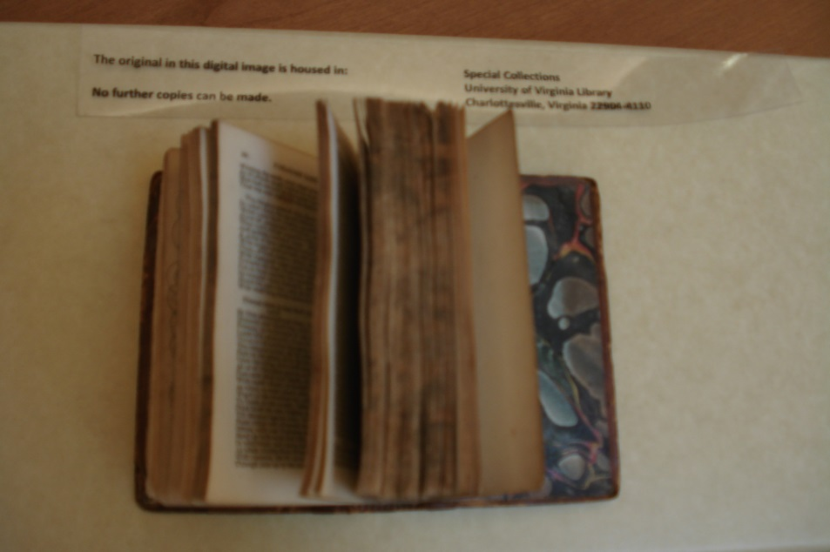
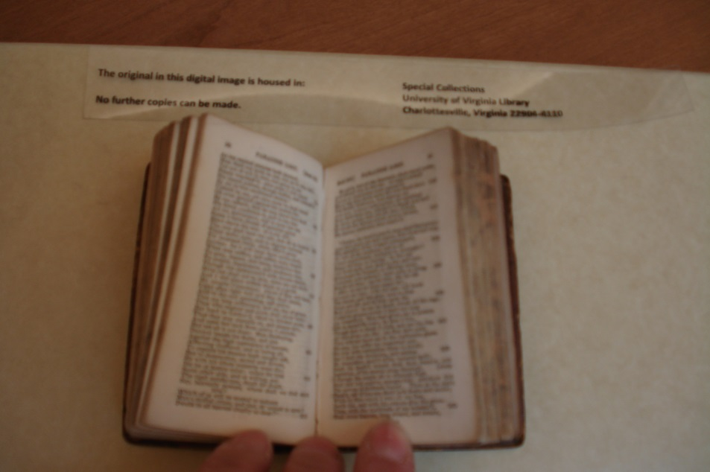
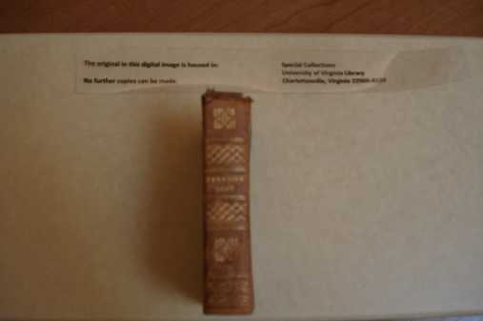
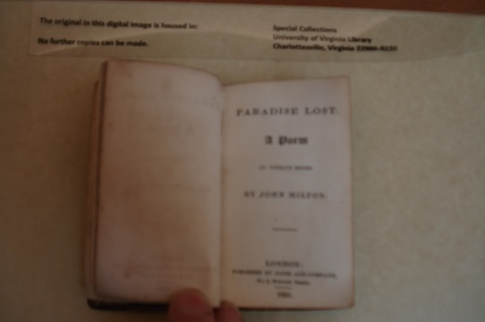
c Jefferson: Creating Personal Space for Self-Reflection c Evidence of Jefferson’s thoughts about his own thinking—metacognition
Paradise Lost by John Milton, 1825. Special Collections, University of Virginia, Charlottesville, VA.
Photos by D. Gerlach; August, 2013

Slide 17
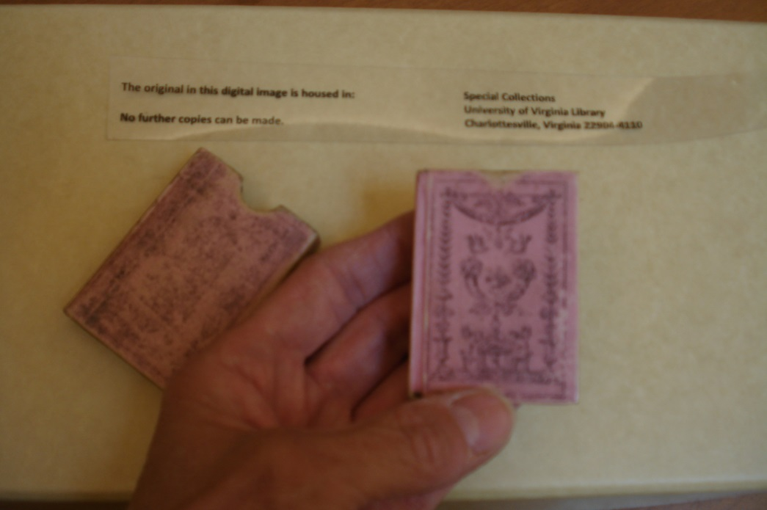
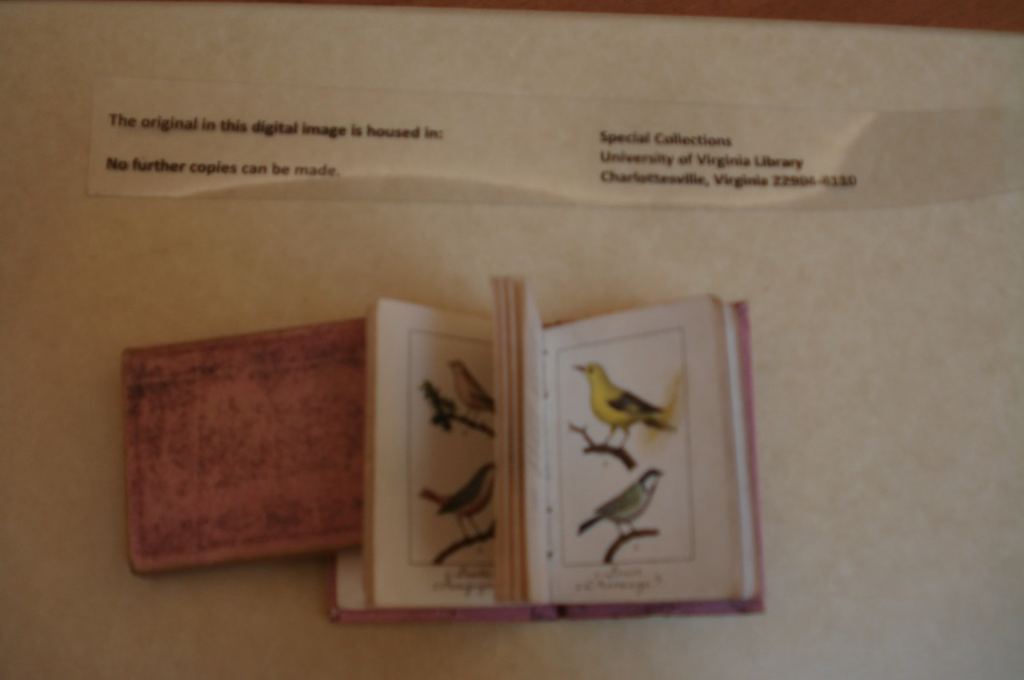
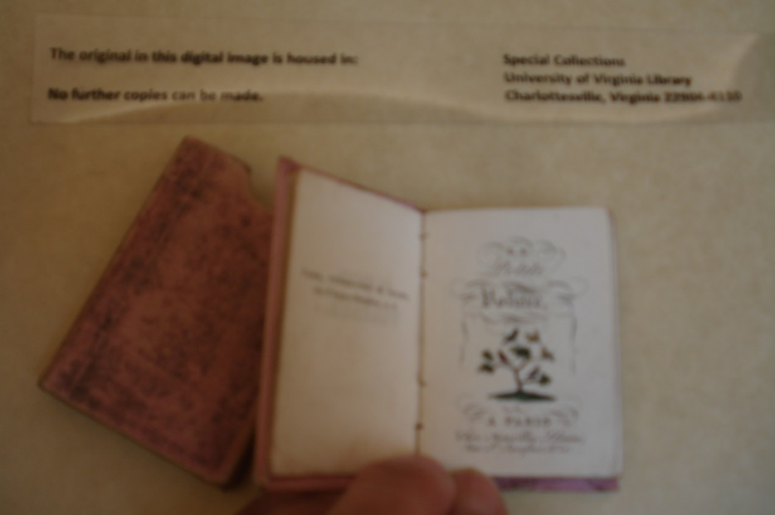
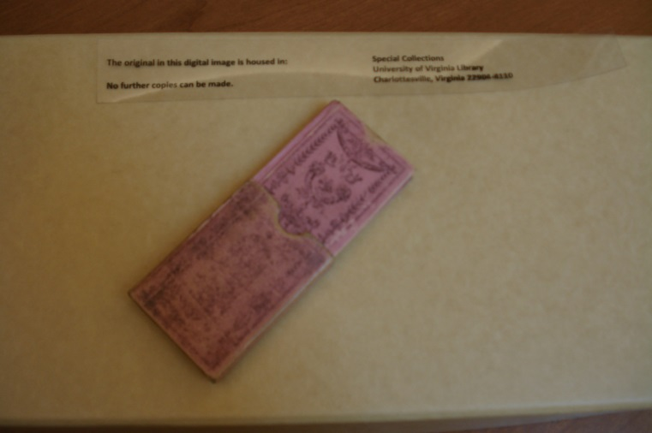
c Jefferson: Creating Personal Space for Self-Reflection c Evidence of Jefferson’s thoughts about his own thinking—metacognition
La Petite volie re, 1820’s. Special Collections, University of Virginia, Charlottesville, VA. Photos by D. Gerlach; August, 2013

Slide 18
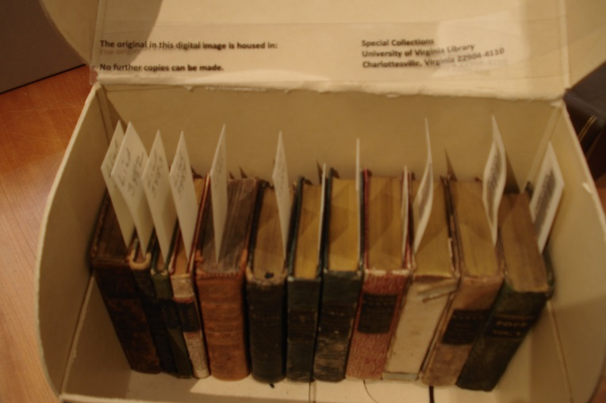
c Jefferson: Creating Personal Space for Self-Reflection c Evidence of Jefferson’s thoughts about his own thinking—metacognition
Refer to the following site to acquire an understanding of Thomas Jefferson’s collection of petit-format books at Poplar Forest: http://www.monticello.org/site/research-and-collections/bookcase-petit-format-book
Collection of petit-format books, Special Collections, University of Virginia, Charlottesville, VA.

Slide 19
c Jefferson: Creating Personal Space for Self-Reflection c Evidence of Jefferson’s thoughts about his own thinking—metacognition
Students: After learning about Thomas Jefferson’s designs for personal space within Monticello and Poplar Forest and the concept of “thinking about thinking,” reflect on a topic that you would like to write about and construct an artifact, a petit-format book.
This is the culminating product of this project-based learning experience. Reflect on information that has been discussed in this unit and personally chose a topic that interests you for your book. Perhaps you will write about a particular character trait; a memorable gardening experience; a poem reflecting nature; questions that you are asking yourselves about your scientific observations similar to Jefferson’s “Queries” he posed in his book, Notes on the State of Virginia 1743-1826 (1787); Jefferson’s pet bird, a mockingbird; travel; your favorite hobby or sport; or a book that Thomas Jefferson would author about his travels or interests. You may like to include any artifacts that relate to the subject matter of your book (i.e. if you are writing about biking, you may want to include a bike route in your book or if you are writing about cooking, you may want to include a favorite recipe). Students should include a Table of Contents in their books that assists them in organizing their thoughts. This concept is evidence of organized thinking reflective of Jefferson’s attention to logical thinking.
Students can share their books with the class and include a discussion of their ideas of personal space
within their environment.

Slide 20
c Jefferson: Creating Personal Space for Self-Reflection c Evidence of Jefferson’s thoughts about his own thinking—metacognition
Suggestion for constructing this artifact, petit-format book:
Use materials found around your house: covers can easily be constructed from leftover cardboard and covered with scraps of fabric or a brown paper bag to give the appearance of leather. The inside pages of the book can be tea-dyed to give an antiqued look. You can use calligraphy to write your story or title on the book.

Slide 21
Bibliography
Flavell, J. H., Miller, P. H., & Miller, S. A. (2002). Cognitive development.
Upper Saddle River, NJ: Pearson Education, Inc.
Jefferson, Thomas. Notes on the State of Virginia, 1743-1826 (1787). Call Number: MCG A 1787
.J45. Albert and Shirley Small Special Collections Library, University of Virginia.
La Petite volie re. (1820’s). Call Number: Lindemann 04359. Albert and Shirley Small Special Collections Library,
University of Virginia.
McLaughlin, Jack. (1988). Jefferson and Monticello: The Biography of a Builder. New York: Henry Holt and Company.
Milton, John. (1825). Paradise Lost. Call Number: Lindemann 03485. Albert and Shirley Small Special Collections
Library, University of Virginia.

