Slide 1
Jefferson’s International Relevance
The Declaration of Independence

Slide 2
Lesson Agenda
Warm-Up: Globalization
Note-taking: Vocabulary
Sorting: Declaration of Independence
Case Study: USA vs. __________
Take-Home Point: To what extent was/is Jefferson’s Declaration of Independence an example of globalization?

Slide 3
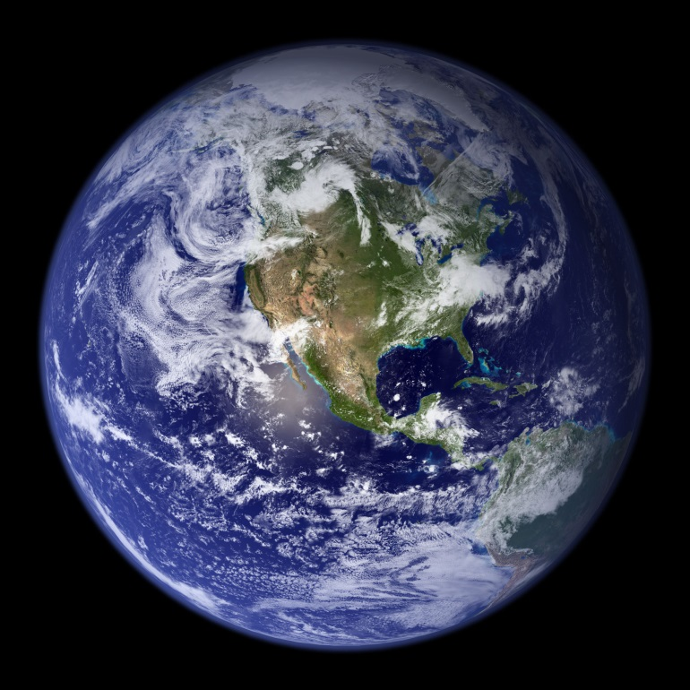
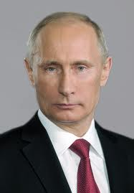
Starter
The term “globalization” means the act of extending to other parts of the world.
What creates globalization today? Describe three examples of how people from around the world exchange ideas and resources.

Slide 4
Lesson Vocabulary
1. globalization (noun): the act of extending to other parts of the world
2. grievance (noun): a reason for complaining or being unhappy with a situation
3. sovereignty (noun): a country's independent authority and the right to govern itself
4. unalienable (adjective): impossible to take away or give up
5. tyranny (noun): cruel and unfair treatment by people with power over others

Slide 5
Sorting Instructions, Part I
Group the strips of paper any way you want. Think of how the strips are similar or different from one another.
Use the Vocabulary Hint Worksheet to help you understand the meaning of the terms.

Slide 6
Sorting Instructions, Part II
Now, sort the strips based on which ones you think are part of the American Declaration of Independence and which ones are not.
Be prepared to discuss your thinking behind your sorting.

Slide 7
Actual Origins of Documents
1. The American Declaration of Independence (July 4, 1776)
2. The Manifesto of the Province of Flanders (January 4, 1790)
3. The Haitian Declaration of Independence (January 1, 1804)
4. The American Declaration of Independence (July 4, 1776)
5. The Texas Declaration of Independence (March 2, 1836)
6. The American Declaration of Independence (July 4, 1776)
7. The American Declaration of Independence (July 4, 1776)
8. The Venezuelan Declaration of Independence (July 5, 1811)
9. The Liberian Declaration of Independence (July 16, 1847)
10. The Unilateral Declaration of Independence (Southern Rhodesia) (November 11, 1965)
11. The Vietnamese Declaration of Independence (September 2, 1945)
12. The Declaration of Independence of the Czechoslovak Nation (October 18, 1918)

Slide 8
Timeline: Declarations of Independence
1776- The American Declaration of Independence
1790- The Manifesto of the Province of Flanders
1804- The Haitian Declaration of Independence
1811- The Venezuelan Declaration of Independence
1836- The Texas Declaration of Independence
1847- The Liberian Declaration of Independence
1918- The Declaration of Independence of the Czechoslovak Nation
1945- The Vietnamese Declaration of Independence
1965- The Unilateral Declaration of Independence (Southern Rhodesia)

Slide 9
Take-Home Point
To what extent was/is Jefferson’s Declaration of Independence an example of globalization?
Answer this question in paragraph form (6-8 sentences) using evidence from the lesson.

