Slide 1
Jefferson’s International Relevance
The Formation of American Political Parties

Slide 2
Lesson Agenda
Warm-Up
Notes
Primary Source Analysis
Political Party Perspectives
Choice Chart

Slide 3
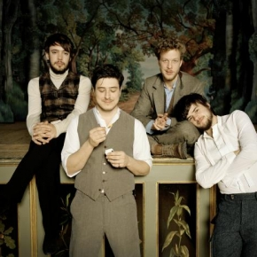
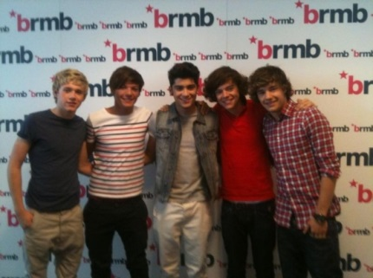
Warm-Up
Famous Groups
1. Why do people work in groups?
2. What are some benefits to working in a group?
3. What are some challenges to working in a group?
4. Describe a time when you worked in a group. Describe the purpose of working in a group as well as the benefits and challenges you faced.
Mumford & Sons
Destiny’s Child
One Direction
Notes:
DESTINY'S CHILD PHOTO 9 [Photograph]. Retrieved August 7, 2013 from: http://www.destinyschild.com/sites/dchild/files/destinyschild009.jpg
BRMB 2 1D 15/08/2011 [Photograph]. (2011). Retrieved August 7, 2013 from:
http://www.onedirectionmusic.com/images/sized/images/sized/remote/www-onedirectionmusic-com-images-bin-photos-band-BRMB_Twitter_15th-559x420.jpg
[Untitled photograph of the band Mumford and Sons]. Retrieved August 7, 2013 from: http://cdn.umg3.net/mumfordandsons/resized/cdn/uploads/galleries/mumford3-290x290.jpeg

Slide 4
Notes
The Formation of American Political Parties

Slide 5
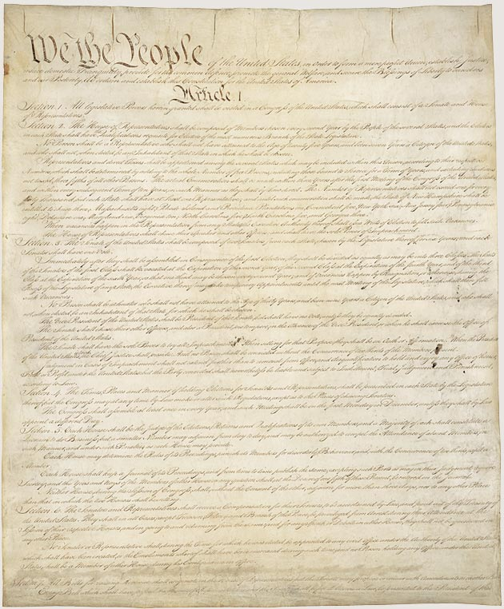
Background
Debates at the Constitution Convention in late 1780s
Federalists vs. anti-Federalists
Federalists: wanted a strong central (national) government to help with economy
Anti-Federalists: feared a strong central government would take a way rights from individuals and states
Constitution is approved of by states
Bill of Rights added
Federalists basically win
US Constitution
Notes:
Constitution of the United States (Part 1 of 4) [Document]. (1787). Retrieved August 7, 2013 from:
http://www.archives.gov/exhibits/charters/images/charters_exhibit_zoom_images/constitution_1_of_4_630.jpg

Slide 6
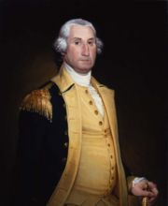
1st President of the USA- George Washington
Was military leader during American Revolution
1st Vice President- John Adams
1st groups of presidential advisors (Cabinet)
Secretary of Treasury- Alexander Hamilton
Secretary of State- Thomas Jefferson
Secretary of War- Henry Knox
Attorney General- Edmund Randolph
George Washington
Notes:
Stevens, Bradley. George Washington [Copy of Painting by John Trumbull and ]oseph Wright]. (1998).
Retrieved August 7, 2013 from: http://www.monticello.org/site/house-and-
gardens/george-washington-painting

Slide 7
Disagreements
Arguments about how US government should work began immediately
Key question: how powerful should the central (national) government be?
Hamilton (& John Adams): Powerful! We don’t want to be so weak the new nation falls apart.
Jefferson (& James Madison): Relatively weak! Give the power to states and individuals!
Thomas Jefferson
Alexander Hamilton
Notes:
Trumbull, J. Miniature Portrait of Jefferson [Painting]. (1788) Retrieved August 7, 2013 from: http://www.monticello.org/site/jefferson/miniature-portrait-jefferson-john-trumbull
Alexander Hamilton (1757–1804) [Painting]. Retrieved on August 7, 2013 from: https://www.nyhistory.org/web/crossroads/images/medium/alexander_hamilton_by_unid.jpg

Slide 8
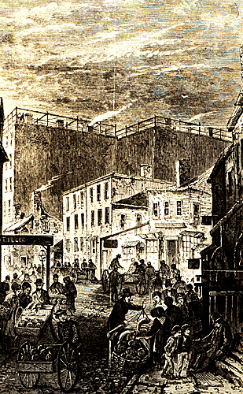
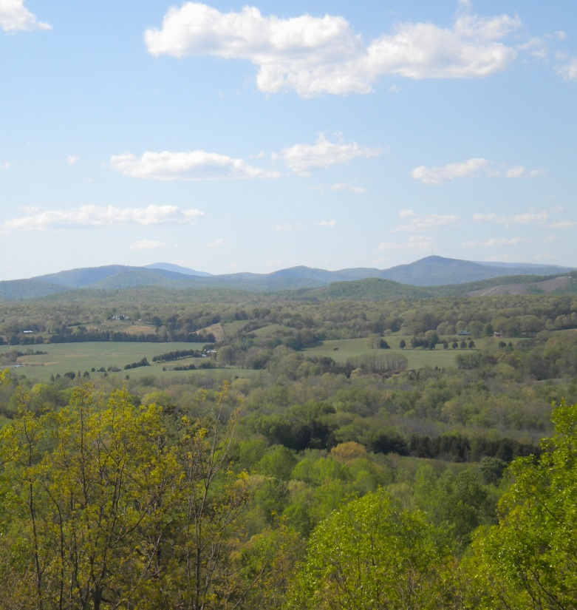
Hamilton’s World
New York City, New York
Jefferson’s World
Albemarle County, Virginia
Notes:
[Untitled image of Seneca Village, New York]. Retrieved August 7, 2013 from: http://www.nyhistory.org/seneca/svsl31.gif

Slide 9
Hamilton’s Thinking
Jefferson’s Thinking
Wanted to have a national bank that would help public credit
Wanted to work with Great Britain for economic benefits
Thought the violence of the French Revolution was a sign that a strong central government was key
Wanted to tax whiskey
Thought a national bank was not a power given to the national government
Didn’t want to work with Great Britain as they were the enemy
Thought the violence of the French Revolution was a natural part of a revolution
Knew whiskey tax would anger poorer populations

Slide 10
Hamilton’s Actions
Jefferson’s Actions
Had the national bank created
Had a tax passed on whiskey > leads to the Whiskey Rebellion
Pointed out Jefferson’s failures as Virginia’s governor
Went to New York with James Madison to stir up anger against Hamilton before 1792 elections
His insults against John Adams accidentally get published in a book
Labels George Washington a Federalist after Washington attacks whiskey tax protestors

Slide 11
Results
Different ways of thinking about government turn into political parties
Jefferson and Madison- Republicans
Hamilton and Adams- Federalists
Adams wins presidential elections in 1796
Jefferson is his vice-president
Jefferson wins presidential elections in 1800
Marks a peaceful transfer of power between political parties
Hamilton dies in a dual in 1804
Madison wins presidential elections in 1808

