Slide 1
The Process of Making Textiles
Gathering the Fibers

Slide 2
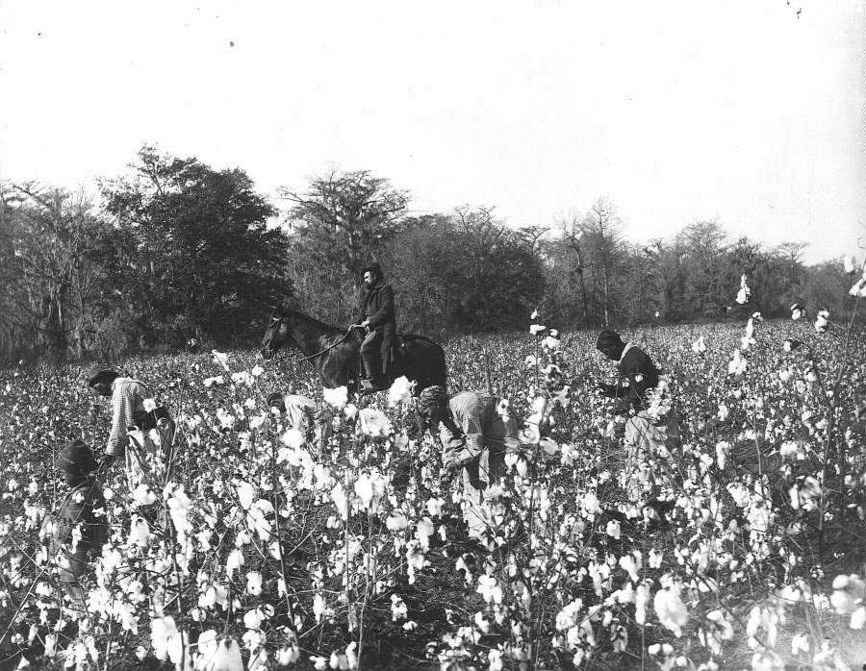
Picking Cotton
Photographer unknown. ca. 1895. http://www.gwu.edu/~folklife/bighouse/panel9.html

Slide 3
Cotton Gin
The Cotton Gin was invented by Eli Whitney in 1793
The cotton gin was used to separate the cotton from the seeds.
This invention caused the demand for cotton to increase.
Photo: Tom Murphy VII.
http://commons.wikimedia.org/wiki/File:Cotton_gin_EWM_2007.jpg

Slide 4
Shearing Sheep
The wool from the sheep is removed through shearing. The fibers are spun into yarn and knitted by hand or machine. They are made into sweaters to be worn in the winter for warmth.
Photo: Martin Pot (martybugs @ en.wikipedia) .
http://commons.wikimedia.org/wiki/File:Sheep_shearing.jpg

Slide 5
Sheep Shearing Demonstration at Young’s Dairy Farm, Yellow Springs, Ohio. Video by David Duke:
https://www.youtube.com/watch v=53KoRxxr1jc

Slide 6
Flax
This fiber comes from a plant. It is used in the making of linen a lightweight material used for summer clothing.
Photo: Rasbak. http://commons.wikimedia.org/wiki/
File:Linum_usitatissimum_flax_products,_vlasproducten_%281%29.jpg

Slide 7
Hemp
The plant is used in the making of rope and coarse clothing. Slave clothing was made from this material at Monticello and on other plantations.
Photo: Rasbak. http://commons.wikimedia.org/wiki/File:Hennepvezel_Cannabis_sativa_fibre.jpg

Slide 8
Silk
This fiber, derived from insect cocoons, is used in the manufacture of luxury items of clothing.
Photo: Gerd A. T. Müller.
http://commons.wikimedia.org/wiki/File:Bombyx_mori_Cocon_02.jpg

Slide 9
Processing the Fibers

Slide 10
Carding Fibers
Photo: Joan Ruane. http://www.cottonspinning.com/spin/makePuni.html

Slide 11
Spinning
Photo: Linda Spashett. http://commons.wikimedia.org/wiki/File:Saxony_spinning_wheel_029.jpg

Slide 12
Demonstration of spinning yarn on a spinning wheel. Video by videojugartscrafts:
https://www.youtube.com/watch?v=ex1Atx1tQPk

Slide 13
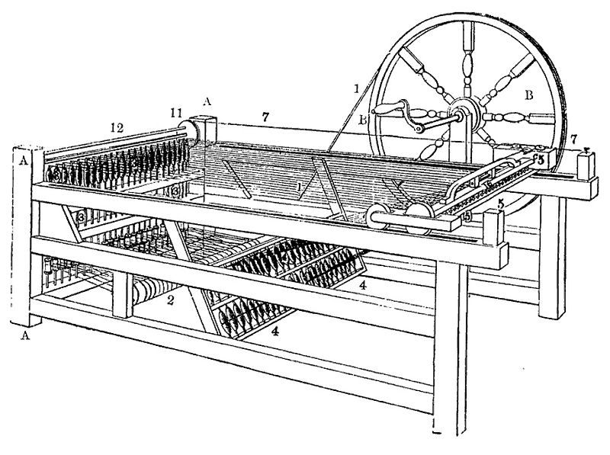
Spinning Jenny
Image from Popular Science Monthly, vol. 39, 1891.

Slide 14
Hand Loom
Photo: Javier Carro. http://commons.wikimedia.org/wiki/File:Webmaschine_in_Tirolervolkskunstmuseum.JPG

Slide 15
Flying Shuttle
Photo: Audrius Meskauskas. http://commons.wikimedia.org/wiki/File:Shuttle_with_bobin_horizontal.jpg

Slide 16
Mechanical Loom
Photo: Enfo. http://commons.wikimedia.org/wiki/File:17_Tinell,_exposici%C3%B3_Indianes,_teler_de_garrot.jpg
Ilustration (left) from the book La deuxième année de géographie, writted by Pierre Foncin, 1882.

