Slide 1
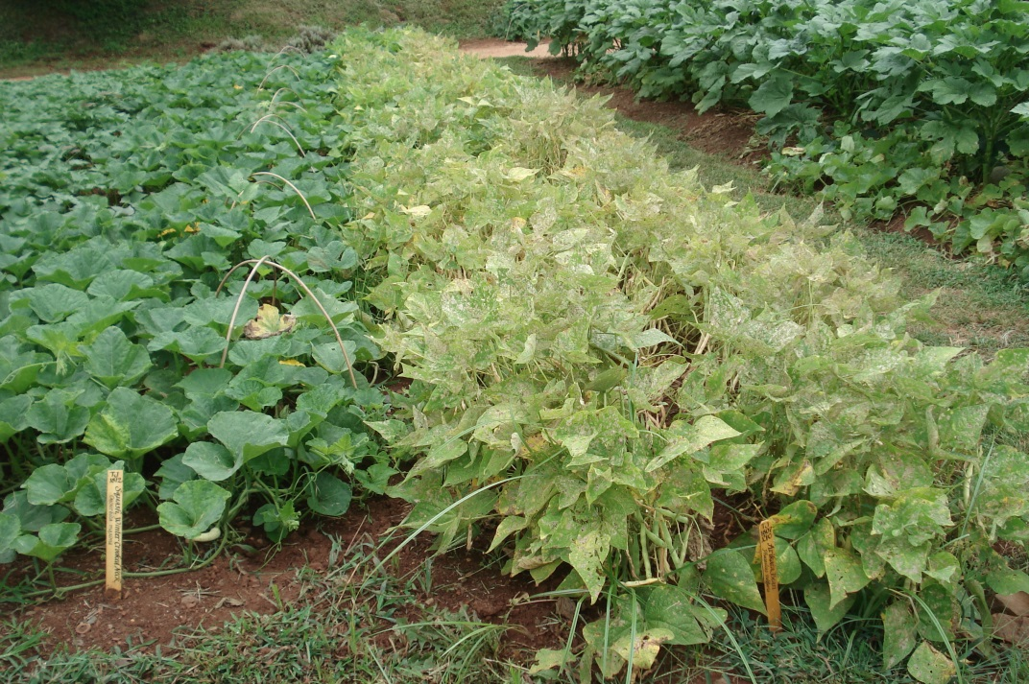
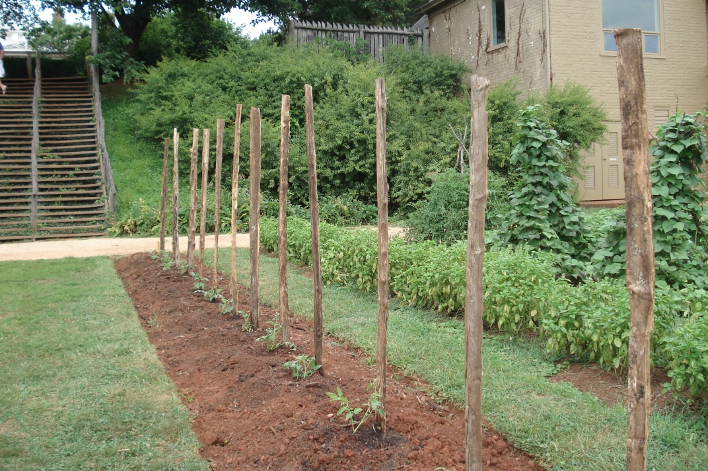
Jefferson’s Gardens: A Landscape of Opportunities c Section 2: An Experimental Vegetable Garden c “A theory must yield to experience.” (Thomas Jefferson to letter James Maury, Monticello, June 16, 1815)
Photos by D. Gerlach of Monticello’s Vegetable Garden taken on July 31, 2013. Note natural supports used for “climbing” vegetables on right.
Darla Gerlach, EdD, Barringer Research Fellow-2013

Slide 2
An Experimental Vegetable Garden
In this section, students will develop an understanding of how Thomas Jefferson incorporated plants and agricultural ideas from multiple foreign countries into his own gardens at Monticello. His fascination with plant experimentation and gardening techniques is meticulously recorded for future generations to expound upon. Jefferson’s tolerance with unsuccessful crops and his determination to persevere with successful solutions provides inspiration to individuals today as he stated: “Botany is the school for patience, and its amateurs learn resignation from daily disappointments.” (Letter to Madame de Tesse, Paris, April 25, 1788).
Students should review the following for background information:
http://www.monticello.org/site/house-and-gardens/jefferson-scientist-and-gardener.
http://www.monticello.org/site/house-and-gardens/19th-century-vegetables-and-cultivation-techniques.
http://www.monticello.org/site/house-and-gardens/site-vegetable-garden.
http://www.monticello.org/site/house-and-gardens/vegetable-garden-today.
http://www.monticello.org/site/house-and-gardens/gardens-and-grounds-image-gallery.
There are 34 articles about Agriculture and Gardening which include pests, crops, plants obtained from the Lewis & Clark Expedition, greenhouses and many more items for students to utilize in their research: http://www.monticello.org/site/house-and-gardens/agriculture-and-garden.
The following article highlights Peter Hatch, author of A Rich Spot of Earth, and his valuable insight in restoring Jefferson’s vision of his garden: http://www.monticello.org/site/house-and-gardens/richspotofearth and http://www.monticello.org/site/house-and-gardens/rich-spot-earth-author-peter-hatch.
Thomas Jefferson’s Center for Historic Plants has a wealth of articles that pertain to plants, pests and garden-related content:
http://www.monticello.org/site/house-and-gardens/twinleaf-journal-online.
Refer to the Photo Gallery online: this is a collection of photographs taken by Darla Gerlach; referencing Monticello vegetable gardens.

Slide 3
An Experimental Vegetable Garden
Procedures for this Lesson:
Review the sections: Environmental Observations of Jefferson:
c Climate
c Water Conservation at Monticello
c Part 1: A Socratic Discussion of Jefferson’s decision to situate Monticello on a mountaintop
c Part 2: A Socratic Discussion of Agricultural Prospects at Montalto
Review the section: Observation of Plant Growth
Complete the activity: A Vegetable Experiment
Review the section: Problem-Solving in the Garden
As students proceed through this lesson, encourage them to reflect on the thoughts of Pat Brodowski, Vegetable Gardener at Monticello, “Find a mentor; someone who loves to garden, find a local lure for where you are and grow something; nurture something on your own. Gardening is always about change…about problem-solving…build on what you learn.”

Slide 4
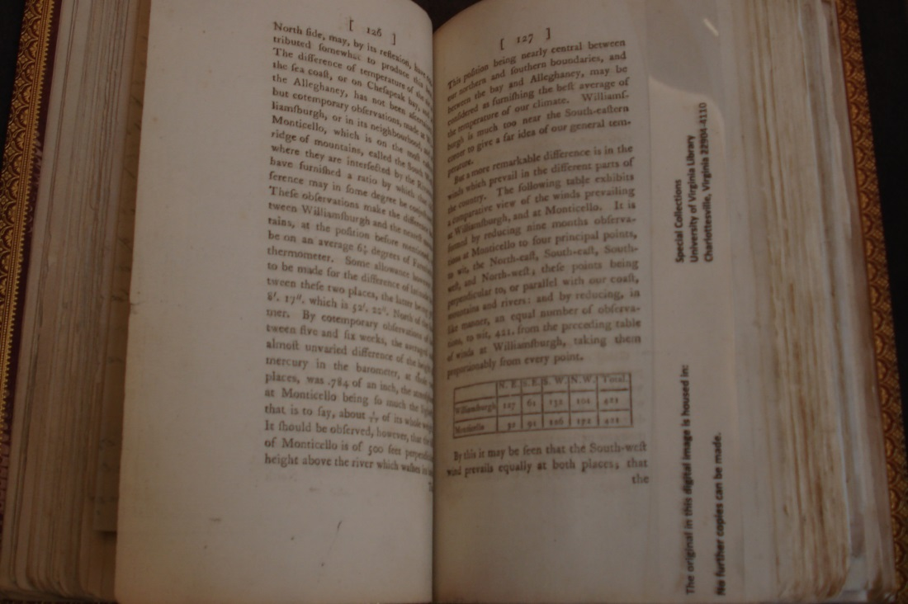
Environmental Observations of Jefferson: Climate
Reflect on the following data:
Thomas Jefferson’s Notes on the State of Virginia, 1743-1826 (1787) are organized in the form of Query 1 – 23. Each query poses a pondering thought and discussion by Jefferson.
Review Jefferson’s comments on the Query VII: A notice of all what can increase the progress of human knowledge:
“But a remarkable difference is in the winds which prevail in different parts of the country. The following table exhibits a comparative view of the winds prevailing at Williamsburgh, and at Monticello. It is formed by reducing nine months of observations at Monticello to four principal points, to wit, the North-West; these points being perpendicular to, or parallel with our coast, mountains and rivers: and by reducing, in like manner, an equal number of observations, to wit, 421. from the preceding table of winds at Williamsburgh, taking them proportionably from every point.” (p. 127)

Slide 5
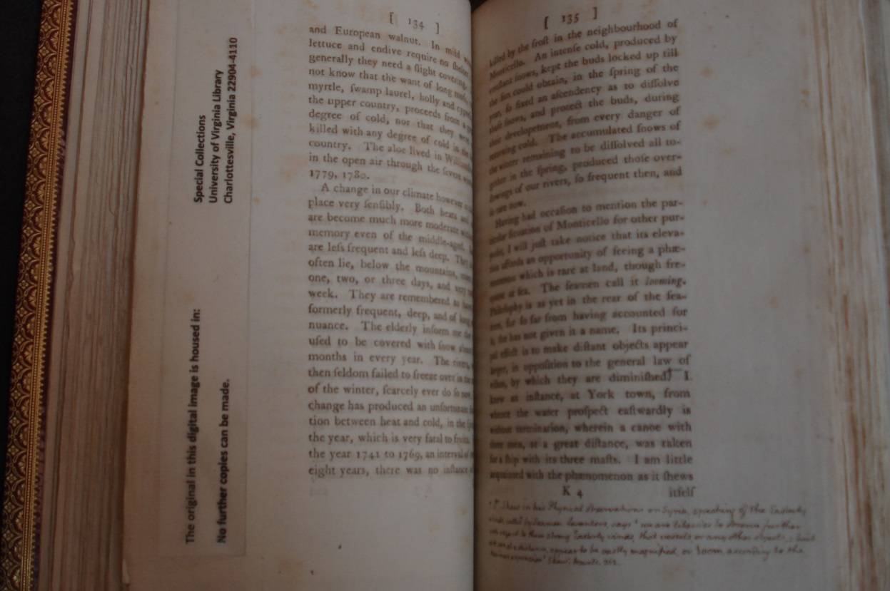
Environmental Observations of Jefferson: Climate
Thomas Jefferson’s Notes on the State of Virginia, 1743-1826 (1787) are organized in the form of Query 1 – 23. Each query poses a pondering thought and discussion by Jefferson. Review Jefferson’s comments on the Query VII: A notice of all what can increase the progress of human knowledge:
“A change in our climate however is taking place very sensibly. Both heats and colds are become more moderate within the memory even of the middle-aged. Snows are less frequent and less deep. They do not often lie, below the mountains, more than one, two, or three days, and very rarely a week. They are remembered to have been formerly frequent, deep, and of long continuance. The elderly inform me the earth used to be covered with snow about three months in every year. The rivers, which then seldom failed to freeze over in the course of the winter, scarcely ever do so now. This change has produced an unfortunate fluctuation between heat and cold, in the spring of the year, which is very fatal to fruits. From the year 1741 to 1769, an interval of twenty-eight years, there was no instance of fruit killed by the frost in the neighborhood of Monticello. An intense cold, produced by constant snows, kept the buds locked up till the sun could obtain, in the spring of the year, so fixed an ascendency as to dissolve those snows, and protect the buds, during their development, from every danger of returning cold. The accumulated snows of the winter remaining to be dissolved all together in the spring; produced those overflowings of our rivers, so frequent then, and so rare now.” (pp. 134-135)

Slide 6
Environmental Observations of Jefferson: Climate
Questions to Ponder:
After reading Jefferson’s observations (in 1787), are there any similarities in his concerns for the environment that have been discussed nowadays and for our future (i.e. global warming, volcanic disturbances; shifts in wind patterns around the world, etc.)?
Do you think Jefferson had an assumption that at this particular time in history climatic changes were taking place—for future generations as well?
As a class, discuss some of the specific observations that Jefferson noted about the seasons and what environmental conditions were taking place.
What did Jefferson use as a basis for comparing environmental changes?
Are you noticing any changes in your community’s environment that are occurring from season to season and year to year?

Slide 7
Environmental Observations of Jefferson: Water Conservation at Monticello
Review the following information on the dilemma of maintaining a constant supply of water at Monticello:
Peter Hatch notes in Thomas Jefferson’s Flower Garden at Monticello, (revised edition, 1971): “No physical problem at Monticello was more difficult of solution than that of a sufficient water supply for the house, the lawns, and the gardens on top of the mountain. The problem grew with the expansion of Monticello. Jefferson had many schemes for solving it, but none worked with satisfaction during his life.” (p. 17).
In addition, reference the following article: http://www.monticello.org/site/house-and-gardens/water-supply.
Jefferson mentions a syphon in his Garden Book in a letter to John Vaughan (Vaughan was known as a catalyst in bringing scientists and historians together); reference http://www.monticello.org/site/research-and-collections/john-vaughan in a letter dated August 31, 1809:
“…P.S. Can you inform me whether the instrument called the Distiller’s syphon is to be had in Philadelphia, and what one sufficient to work in a cistern (Jefferson was then building his four cisterns) of 8. feet would cost? I believe they are usually made of tin…”.

Slide 8
Environmental Observations of Jefferson: Water Conservation at Monticello
Thomas Jefferson’s Notes on the State of Virginia, 1743-1826 (1787) are organized in the form of Query 1 – 23. Each query poses a pondering thought and discussion by Jefferson.
Review Jefferson’s comments on the Query VI: A notice of mines, and other subterraneous riches; its trees, plants, fruits, & c.:
“Syphon fountains: There is one of these near the intersection of the Lord Fairfax’s boundry with the North Mountain, not far from Brock’s gap, on the stream of which is a grist mil, which grinds two bushel of grain, at every flood of spring.” (p. 56)
Note: In this book, Jefferson inserted a piece of paper with a drawing of a syphon fountain and the following excerpt: “We are told that during a great storm on the 25th of Dec. 1798 the Syphon fountain near the mouth of the North Holstown ceased, and…”
Refer to the following slide to view Jefferson’s notations and illustration on the syphon fountains in his Notes on the State of Virginia, 1743-1826.

Slide 9
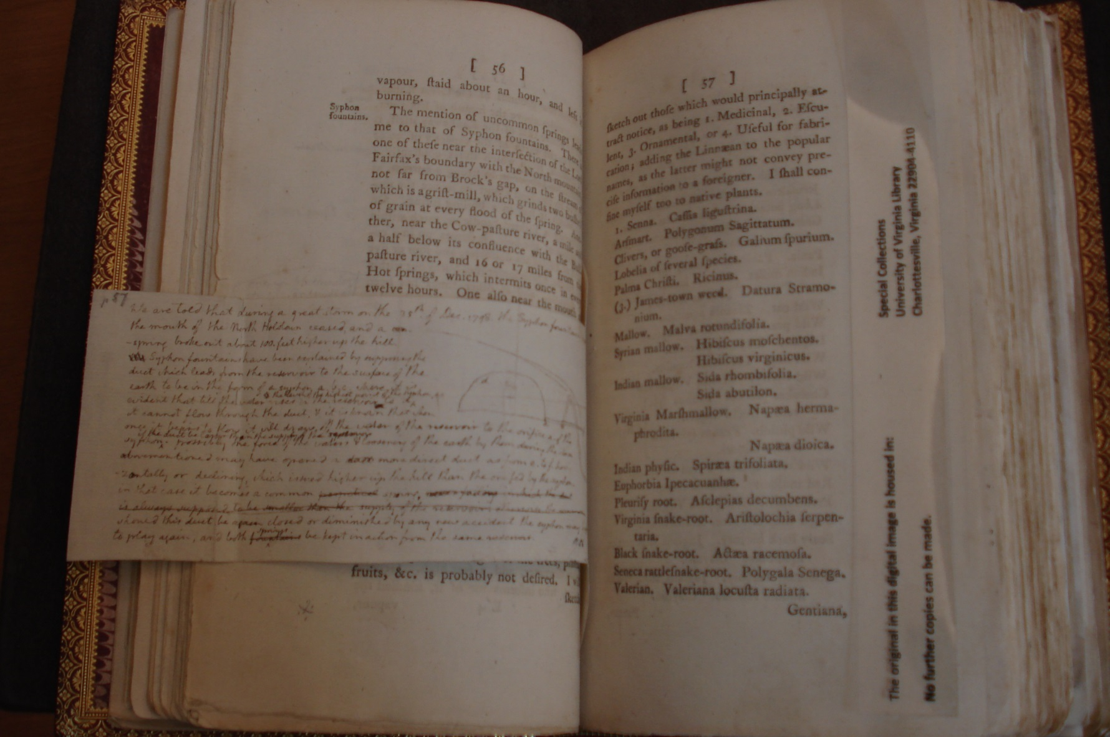
Water Conservation at Monticello
Thomas Jefferson’s Notes on the State of Virginia, 1743-1826 (1787) are organized in the form of Query 1 – 23. Each query poses a pondering thought and discussion by Jefferson.
Review Jefferson’s comments on the Query VI: A notice of mines, and other subterraneous riches; its trees, plants, fruits, & c.:

Slide 10
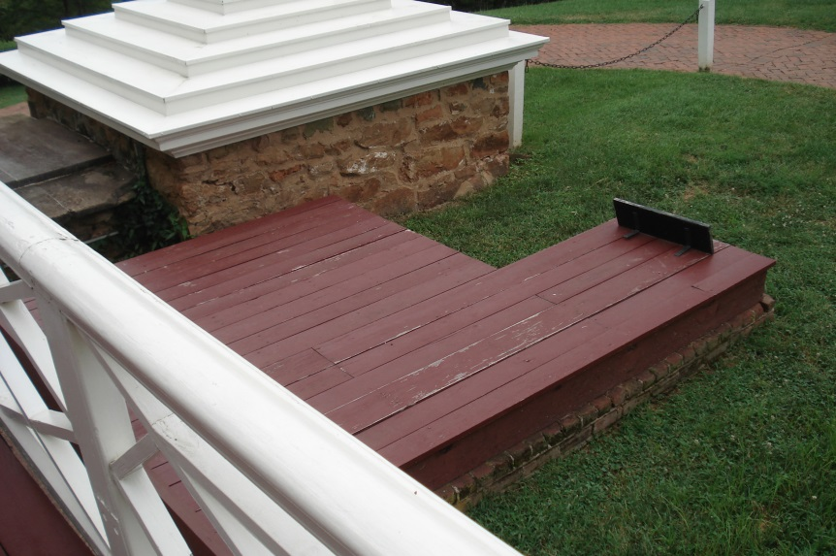
Environmental Observations of Jefferson: Water Conservation at Monticello
“Due to shortages of water on the mountaintop, Jefferson installed cisterns at four locations of the house. They were used to collect rainwater from the rooftop and walkways. Each cistern held 3,830 gallons.”
(from signage at Monticello)
Photos by: D. Gerlach, July 31, 2013

Slide 11
Environmental Observations of Jefferson: Water Conservation at Monticello
Questions to Ponder:
Do you think Jefferson was investigating the use of syphons to extract water from the springs?
What difficulties would he encounter searching for and extracting water from springs?
Would syphons be a reliable means of obtaining water on Monticello’s site (i.e. a mountain)?
Can you think of other methods that Jefferson could have utilized to conserve water at Monticello?

Slide 12
Environmental Observations of Jefferson Part 1: A Socratic Discussion of Jefferson’s decision to situate Monticello on a mountaintop c
In Thomas Jefferson’s Notes on the State of Virginia, 1743-1826 (1787), Query VII: A notice of all what can increase the progress of human knowledge, he states:
“Having had occasion to mention the particular situation of Monticello for other purposes, I will just take notice that its elevation affords an opportunity of seeing a phaenomenon which is rare at land, though frequent at sea. The seamen call it “looming.” Philosophy is as yet in the rear of the seamen, for so far from having accounted for it, she has not given it a name. Its principle effect is to make distant objects appear larger, in opposition to the general law of vision, by which they are diminished.” (p. 135)
Reference the following sites to learn about Jefferson’s knowledge of microclimate: http://www.monticello.org/site/blog-and-community/posts/jefferson%E2%80%99s-progressive-use-microclimate; http://www.monticello.org/site/research-and-collections/weather-observations.
Read the following site to acquire a more in-depth understanding of a microclimate: http://www.princeton.edu/~achaney/tmve/wiki100k/docs/Microclimate.html.

Slide 13
Environmental Observations of Jefferson Part 1: A Socratic Discussion of Jefferson’s decision to situate Monticello on a mountaintop c
Questions to Ponder (use the handouts: The Socratic Circle and The Socratic Circle Handout: Part 1: A Socratic Discussion of Jefferson’s decision to situate Monticello on a mountaintop; Part 2: Agricultural prospects of Montalto):
Based on your readings of microclimate, discuss advantages and disadvantages to consider in growing vegetation on the mountaintop, Monticello.
In the discussion, include Jefferson’s comments:
In Thomas Jefferson’s Notes on the State of Virginia, 1743-1826 (1787), Query VII: A notice of all what can increase the progress of human knowledge. (p. 135), he comments:
“Having had occasion to mention the particular situation of Monticello for other purposes…” and further, “its elevation affords an opportunity…”.
After reading Jefferson’s comments, does it appear that he is confident of situating his plantation on top of a mountain? What words indicate this in the passages?
Do you think Jefferson has proven to his peers that it was an inventive decision to locate his plantation on a mountaintop? Support your answer with facts and conclusions that you have drawn from your research.

Slide 14
Environmental Observations of Jefferson Part 2: A Socratic Discussion of Agricultural Prospects of Montalto c
Students should review the following prior to the discussion:
http://www.monticello.org/site/research-and-collections/montalto.
http://www.monticello.org/site/give/montalto.
In his book, Thomas Jefferson: Scientist, Edwin T. Martin mentions:
“Unlike many eighteenth-century progressivists, Jefferson was no radical visionary, blandly ignoring discouraging realities. Yet his ideas were founded on the optimistic belief that the ‘light which has been shed on the mind of man through the civilized world, has given it a new direction from which no human power can divert it.’ He saw America headed rapidly toward ‘destinies beyond the reach of mortal eye.’” (Martin, p. 64).
*Students should view the photos of Montalto (following) as Part 2 of the Socratic Discussion is held.*
Question for discussion: Do you think it is possible to grow crops on Montalto? (Note that this is a taller mountain than Monticello). Support your answers with research from the above articles.

Slide 15
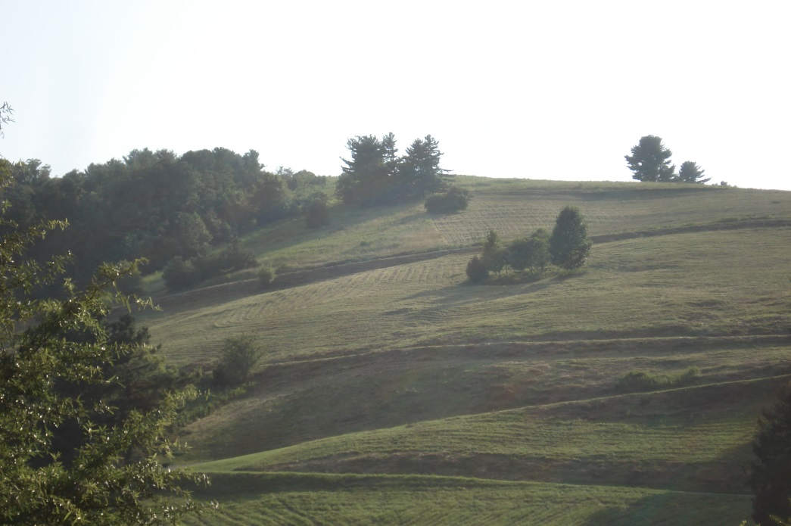
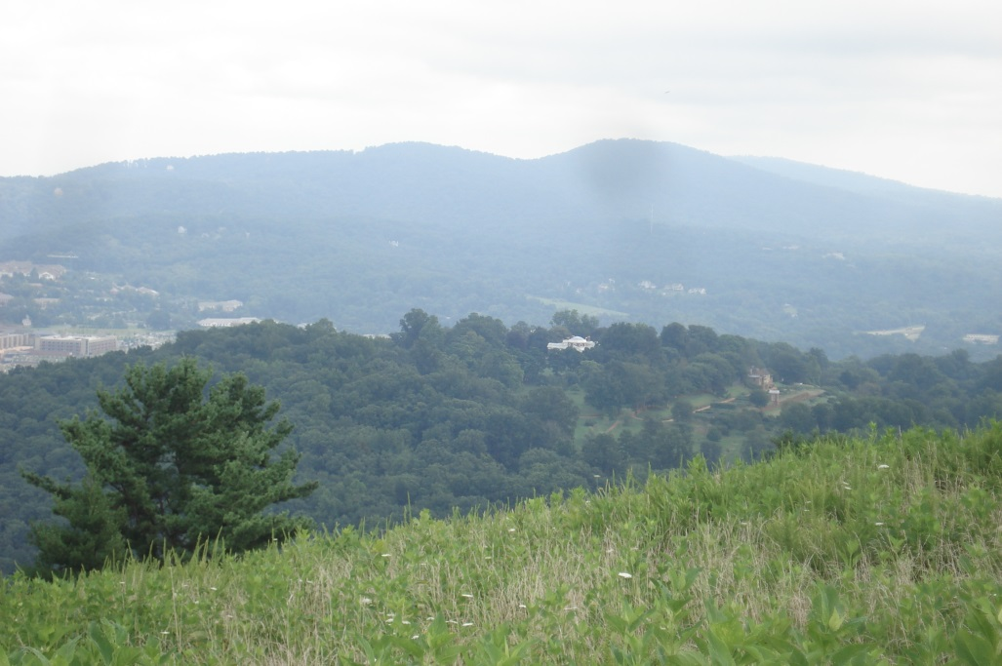
Environmental Observations of Jefferson Part 2: A Socratic Discussion of Agricultural Prospects of Montalto c
Photos by Darla Gerlach, August 6, 2013 of Montalto. Left: View of Montalto from Monticello; Right: View atop Montalto.

Slide 16
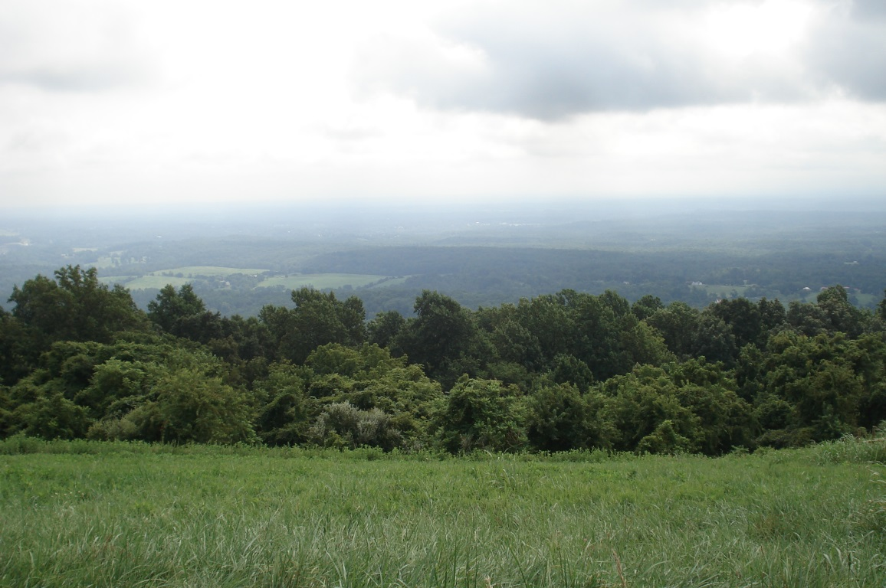
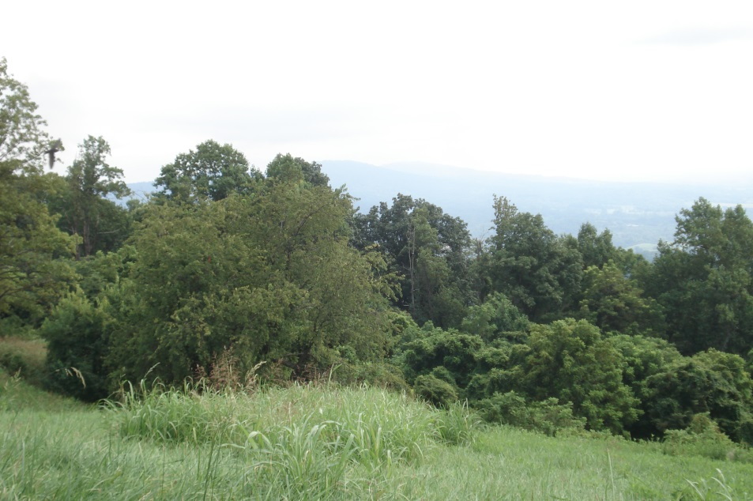
Environmental Observations of Jefferson Part 2: A Socratic Discussion of Agricultural Prospects of Montalto c
Photos by Darla Gerlach, August 6, 2013 from atop Montalto.

Slide 17
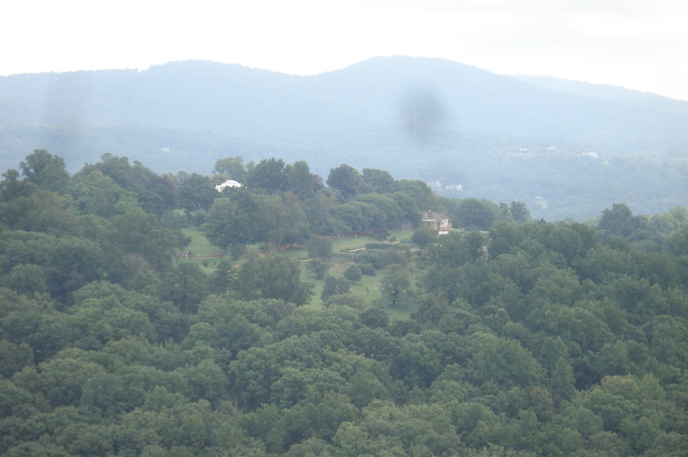
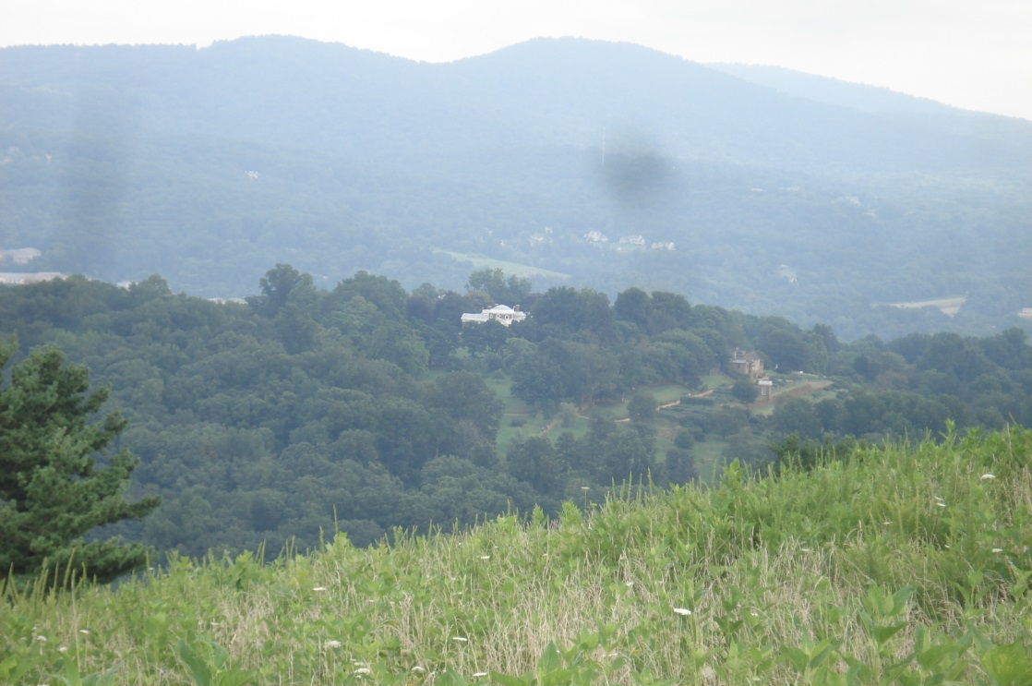
Environmental Observations of Jefferson Part 2: A Socratic Discussion of Agricultural Prospects of Montalto c
Photos by Darla Gerlach, August 6, 2013. View of Monticello atop Montalto.

Slide 18
Environmental Observations of Jefferson Part 2: A Socratic Discussion of Agricultural Prospects of Montalto c
AFTER Part 2 of the Socratic Discussion is held, show the following photos to students and inform them that vineyards are being constructed on Montalto. Ask students to discuss their ideas of applying Jefferson’s concept of microclimate to the conditions at Montalto (in regards to growing grapes there).

Slide 19
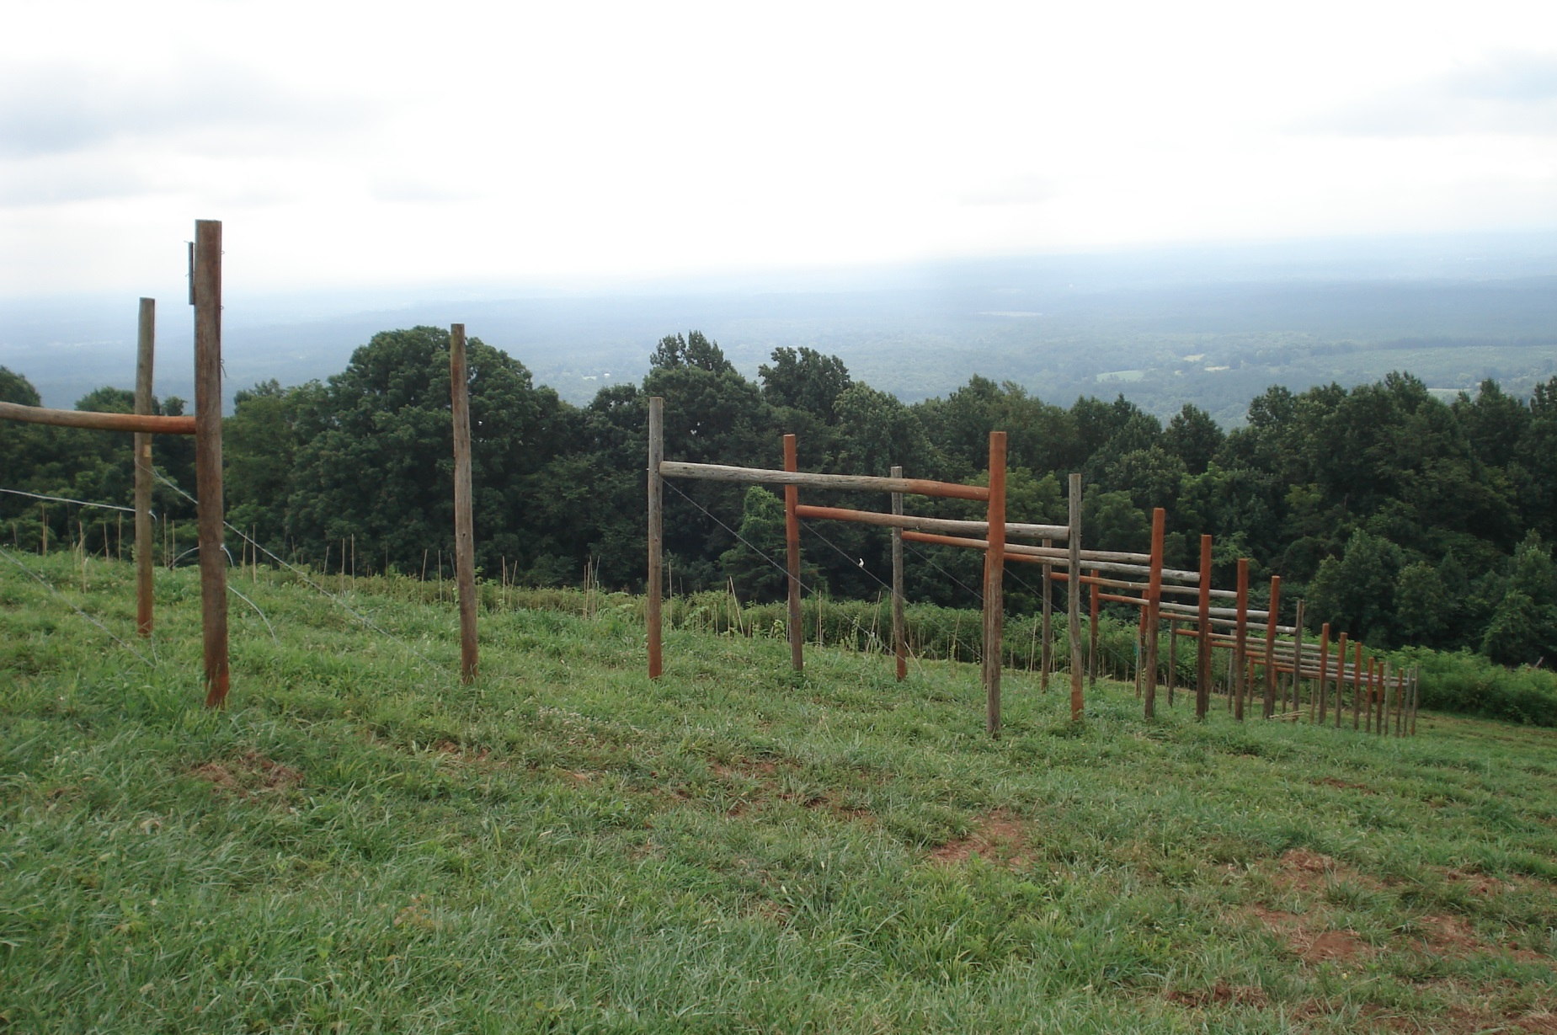
Environmental Observations of Jefferson Part 2: A Socratic Discussion of Agricultural Prospects of Montalto c

Slide 20
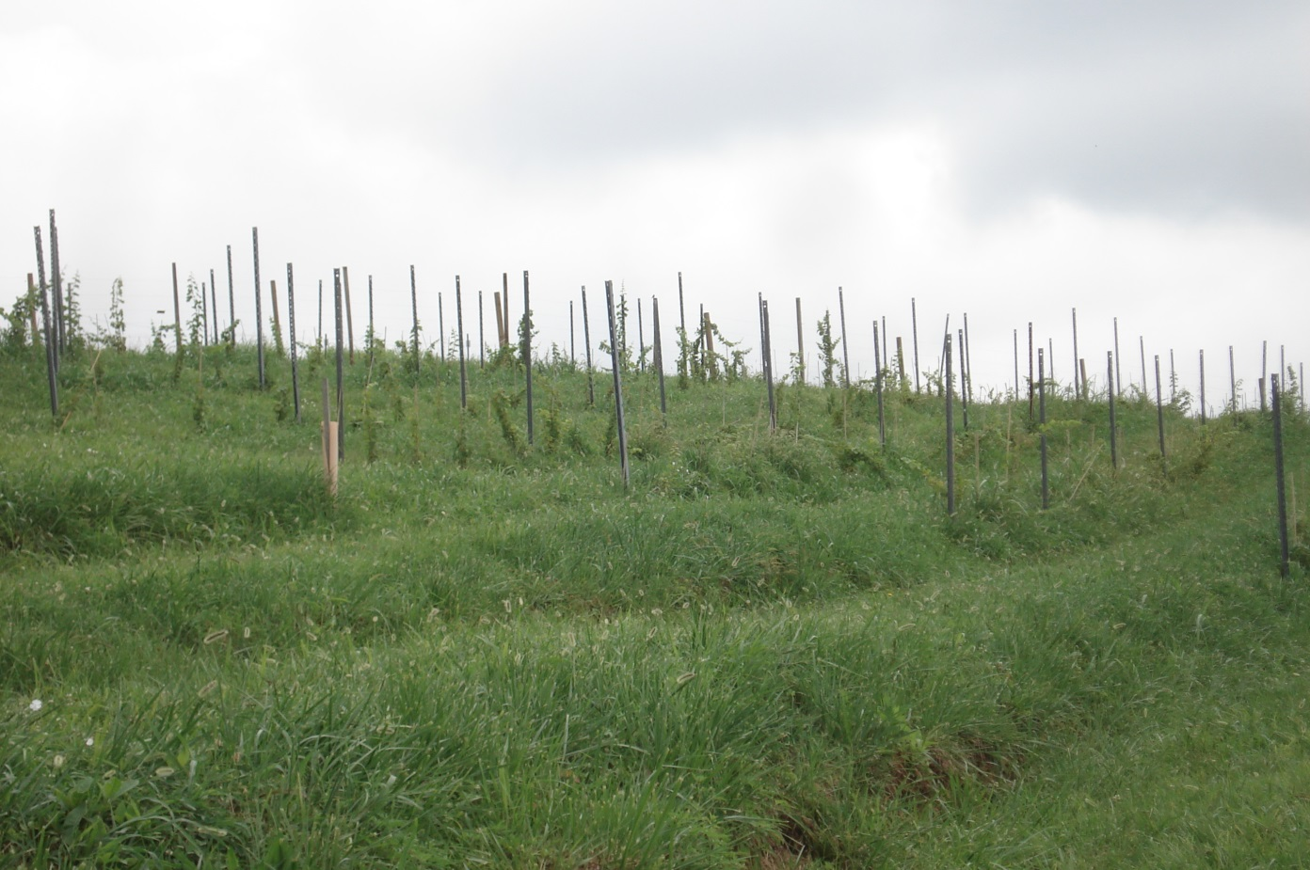
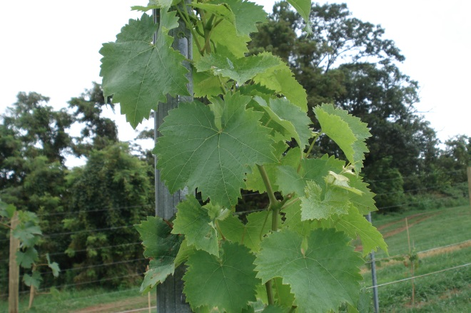
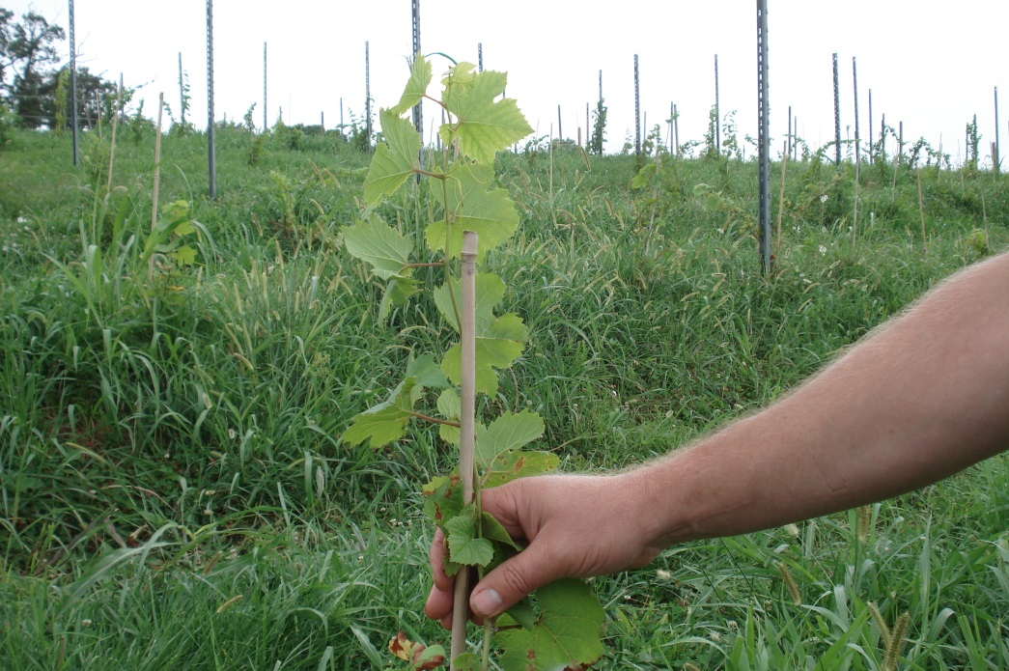
Environmental Observations of Jefferson Part 2: A Socratic Discussion of Agricultural Prospects of Montalto c
Photos by Darla Gerlach, August 6, 2013 of the vineyards atop Montalto.
Special thanks to Oliver Asberger, Fruit Gardener, Monticello

Slide 21
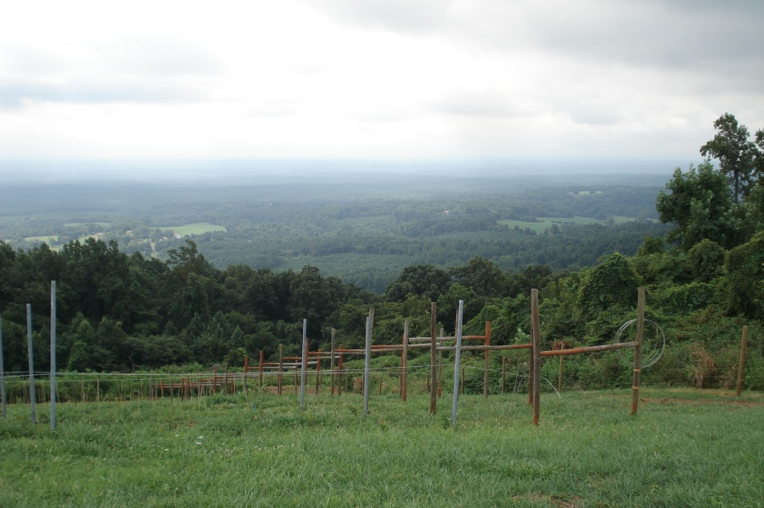
Environmental Observations of Jefferson Part 2: A Socratic Discussion of Agricultural Prospects of Montalto c
After students have viewed the photos of the vineyard, discuss the concept of viticulture:
taking care of a vineyard. Oliver Asberger, Fruit Gardener, explains that being on a mountain has its benefits:
helps the air flow
cold air sinks downward, warm air rises
if you are situated in a valley, you are more prone to frost
Other things to consider:
terracing is a more challenging environment to plant crops
fruits and vine-growing plants are prone to fungus
Thomas Jefferson may not have been knowledgeable on how to deal with fungus. This is a concern on the Eastern Coast of the U.S. considering humidity levels along with rainfall.
Oliver mentions that “Agriculture is hard labor and you
have to love what you are doing—you have the
opportunity to see something grow and harvest it; you
refine grapes and the tradition that comes with the
harvest is rewarding.”

Slide 22
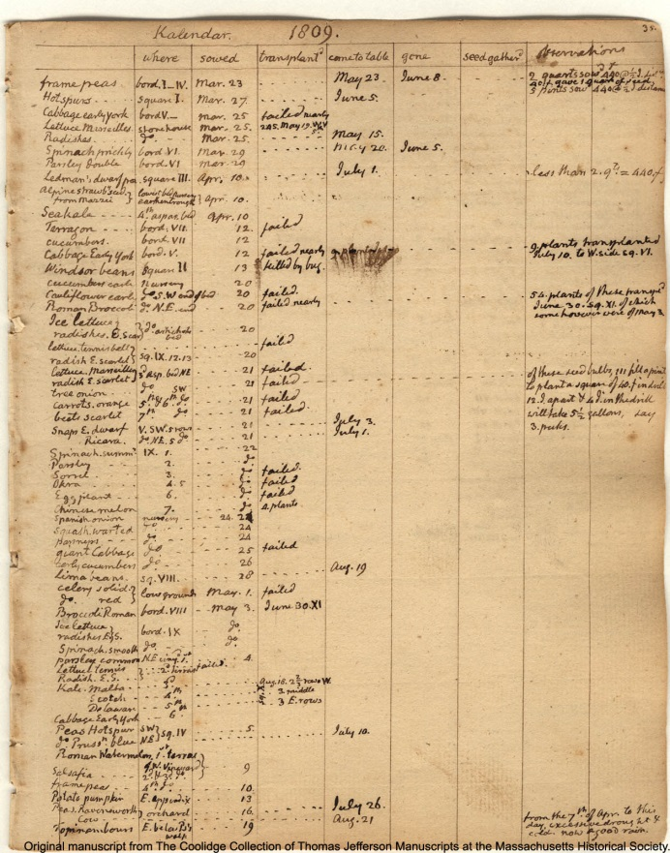
Observation of Plant Growth c
Garden Book, 1766-1824, page 35, by Thomas Jefferson [electronic edition]. Thomas Jefferson Papers: An Electronic Archive. Boston, Mass. : Massachusetts Historical Society, 2003. http://www.thomasjeffersonpapers.org/
In a letter to William H. Crawford, February 11, 1815, Thomas Jefferson stated, “Experience alone brings skill.”
Observe Jefferson’s detailed record keeping of his plants. Think about Jefferson’s expectations when he planted vegetable seeds and small seedlings. What environmental conditions did he have to consider?
Now, think about the “USDA Hardiness Zone” that you live in; refer to http://planthardiness.ars.usda.gov/PHZMWeb/.
What kinds of plants would be most suitable for your environment?
What information did Jefferson have available to make a decision about planting his vegetables?

Slide 23
A Vegetable Experiment
Here’s an opportunity for students to record their observations of growing a vegetable. Monitor the progress on the growth of a radish making notations on the following conditions: temperature, length of germination, soil conditions, water, and other environmental conditions during the growth of the radish. Pat Brodowski, Vegetable Gardener at Monticello, suggests the following experiment for students to observe vegetable growth. Pat mentions that radishes are planted in between crops to serve as borders in distinguishing one plant crop from another in Monticello’s vegetable garden. They are purposeful in this manner as the radish is a fast grower!
A Vegetable Experiment: Growing Radishes
Procedures:
Lay a plastic bag (i.e. plastic grocery bag) flat on a surface; place potting soil lengthwise along one edge of the bag.
Gently roll the plastic bag in one direction and secure the edges of the bag with twine to assure it will not unravel; creating a sausage-like shape.
Carefully punch small holes along the top of the roll.
Drop radish seeds into the holes and sprinkle a very light amount of soil over the seeds.
Gently sprinkle water over the seeds and soil.
Place the roll on a windowsill.
Continue to water until the radishes reach maturity.
Monitor the growth of the radishes by using the handout, Vegetable Growth Chart, and observe the radish leaves as the vegetable matures; refer to the handout, Observation of Radish Growth which illustrates the shape of the radish leaf. Overall, students can note various factors that affect the growth of the radishes: temperature, water, amount of sunlight, etc. as the radish seeds germinate.
Keep in mind that Jefferson completed detailed notes to learn about plant growth.
After the radishes are grown and harvested, students should compare the growth conditions that they observed and monitored with their plants. Create a class chart to note similarities among the students’ records and the best growing practices that they achieved for their vegetables.

Slide 24
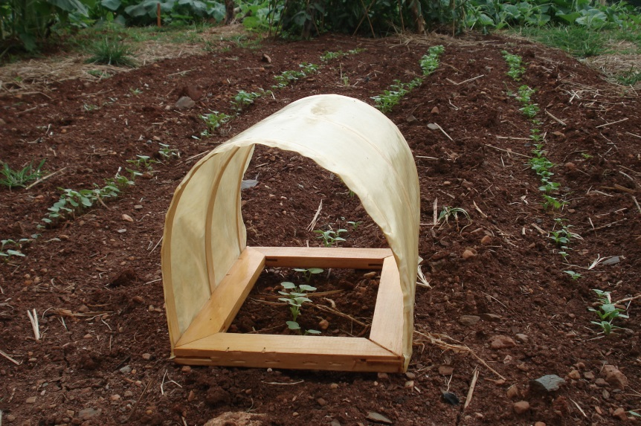
Problem-Solving in the Garden c
Gardening requires experimentation and patience. After students have grown their radishes, ask them to reflect on how they could have changed their methods.
Ask students: If you started your seeds outdoors, what general weather conditions do you have to consider?
Pat Brodowski, Monticello Vegetable Gardener, is experimenting with a solution to protect young plants in the gardens at Monticello. Her solution: think of a structure that covers the plants to protect them from frost but will allow air flow. She constructed a model “paper frame.” These frames can also be used to extend the growing season of a plant and to shelter them.
In Bernard McMahon’s book, The American Gardener’s Calendar (which Jefferson used extensively), he explains how to construct a paper frame.
Pat Brodowski’s model of Paper Frame; Photo by Darla Gerlach, August 8, 2013

Slide 25
Suggested Reading for Classroom Gardening Activities c
Pat Brodowski suggests the following books for classroom gardening projects:
All About Vegetables, edited by Walter L. Doty, published by Chevron Chemical Company, Ortho-Division-Garden & Home, CA, 1973.
How to Grow More Vegetables, by John Jeavons, published by Ten Speed Press, CA, 1982.
Heirloom Vegetable Gardening, by William Woys Weaver, published by Henry Holt and Company, NY, 1997.
Forgotten Household Crafts, A Portrait of the Way We Once Lived, by John Seymour, published by Alfred A. Knopf, NY, 1987.
Flora Mirabilis, How Plants Have Shaped World Knowledge, Health, Wealth , and Beauty, by Catherine Herbert Howell, published by National Geographic, Washington, DC.
Seeing Trees, by Nancy Ross Hugo, published by Timber Press, OR, 2011.

Slide 26
Bibliography
Hatch, Peter J. (2012). A Rich Spot of Earth: Thomas Jefferson’s Revolutionary Garden at Monticello.
New Haven & London: Yale University Press.
Hatch, Pete J. (1971). Thomas Jefferson’s Flower Garden at Monticello. Charlottesville and London:
University of Virginia Press.
Jefferson, Thomas. Notes on the State of Virginia, 1743-1826 (1787). Call Number: MCG A 1787
.J45. Albert and Shirley Small Special Collections Library, University of Virginia.
Martin, Edwin T. (1952). Thomas Jefferson: Scientist. New York: Henry Schuman, Inc.

