Slide 1
Thomas Jefferson, the Enlightenment, and the Declaration of Independence

Slide 2
The Revolution and the Enlightenment
Philosophy = beliefs and ideas people have
The American Patriots were very influenced by the philosophies of the European Enlightenment
  John Locke
  Baron de Montesquieu
  Voltaire
  Jean Jacques Rousseau
Enlightenment = period in the 18th century when many writers and scientists believed that science and knowledge, not religion, could improve people’s lives

Slide 3
What Enlightenment thinkers believed about government
John Locke | Voltaire | Jean Jacques Rousseau
 |  | Baron de Montesquieu
All men created equal
Everyone has God-given human rights
Your rights are to “life, liberty & property”
Government’s job is to protect human rights
Governments rule by consent of the governed
If a government doesn’t do that, the people can overthrow it
Freedom of speech
Freedom of religion
Separation of church and state
Every government takes away your rights
Best government is a democracy because you at least get to vote
Separation of church and state = the idea that the government should not make an official religion or put one religion ahead of another
Democracy = a form of government where the people vote
Checks and balances = a situation where different parts of the government can stop each other from getting too much power
Consent of the governed = a phrase that means the people of a country are giving their permission to the government to do something
Best government has checks and balances to stop someone from getting too much power

Slide 4
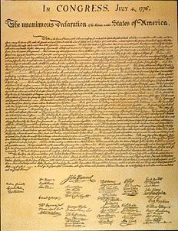
The Declaration of Independence
Enlightenment philosophies

Slide 5
The Declaration of Independence
Continental Congress = a group of representatives from the 13 American colonies that became America’s government during the Revolutionary War
It is a document that says the American colonies had were now free from England
Written in 1776 by Thomas Jefferson
Approved by the Continental Congress on July 4, 1776
Seen as the beginning of the United States of America
Colony = an area of land that is controlled by another country that is far away

Slide 6
Jefferson used the Enlightenment to argue for independence
The 3 parts of the Declaration
  Philosophy: the Enlightenment ideas about government that showed that the Americans had the right to be free from England
  Grievances: complaints that the Americans had against King George III (3rd) showing that he was a bad king
  Declaration of independence: a statement that the colonies were now free and independent states and no longer English colonies

Slide 7
The most famous part is all about the Enlightenment…
Follow along on your worksheet, making notes about the words you do not know so that you understand this very important quote.

Slide 8
We hold these truths to be self evident: That all men are created equal; that they are endowed by their Creator with certain unalienable rights; that among these are life, liberty, and the pursuit of happiness

Slide 9
That to secure these rights, Governments are instituted among Men, deriving their just powers from the consent of the governed,

Slide 10
That whenever any Form of Government becomes destructive of these ends, it is the Right of the People to alter or to abolish it, and to institute new Government.

Slide 11
Find 6 places where Enlightenment beliefs are in this quote:
We hold these truths to be self evident:
1
that they are endowed by their Creator with certain unalienable rights;
That all men are created equal;
2
that among these are life, liberty, and the pursuit of happiness;
3
that, to secure these rights, governments are instituted among men,
4
deriving their just powers from the consent of the governed;
5
that whenever any form of government becomes destructive of these ends, it is the right of the people to alter or to abolish it, and to institute new government
6

Slide 12
The Summary of the Declaration of Independence
Oppress = to cruelly keep a group of people from being free or doing what they want
That Americans were wrongly oppressed by Britain
That because of this they had the right to get rid of the British government
That they could set up a government that was better than any ever seen before
  A democratic republic
Democratic republic = a government where the people vote for representatives who make their laws

Slide 13
Facts About the Declaration of Independence
Written by Thomas Jefferson
Signed on July 4, 1776 by colonial leaders at the Continental Congress
By signing the Declaration of Independence, all these men were committing treason and could be hanged if caught
Now it is at the National Archives in Washington D.C.
Treason = working against your country
To hang = to kill someone by tying them up high with a rope around their neck

Slide 14
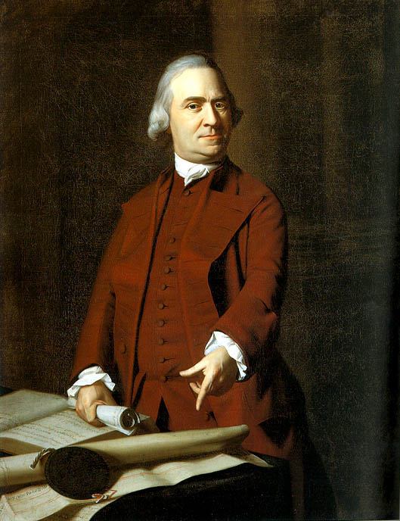
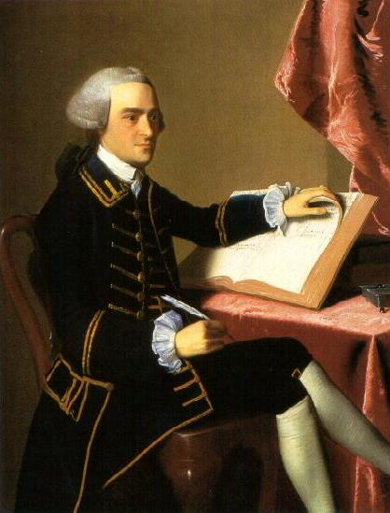
Some famous Declaration Signers
Sam Adams
John Hancock

Slide 15
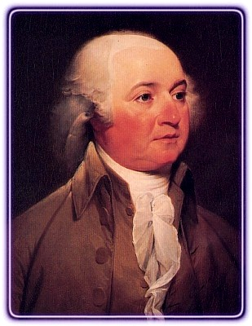
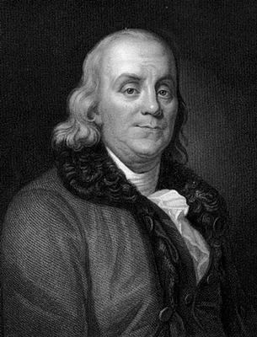
Some famous Declaration Signers
John Adams
Ben Franklin

Slide 16
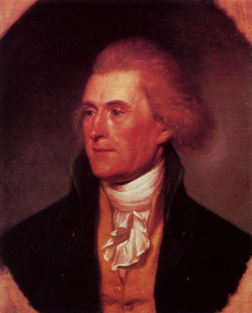
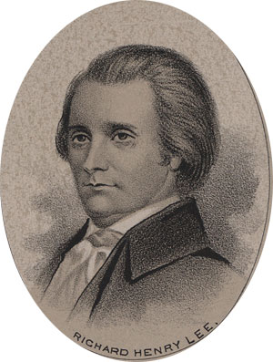
Some famous Declaration Signers
Thomas Jefferson
Richard Henry Lee

